Slide 1


Slide 2






☑HTML
In order to learn jQuery you need to know:
content
☑ CSS
style
JavaScript
behavior

Slide 3
level1

Slide 4

What is jQuery?

Slide 5


What you can do with jQuery
reveal interface elements
1.1 What is jQuery?

Slide 6
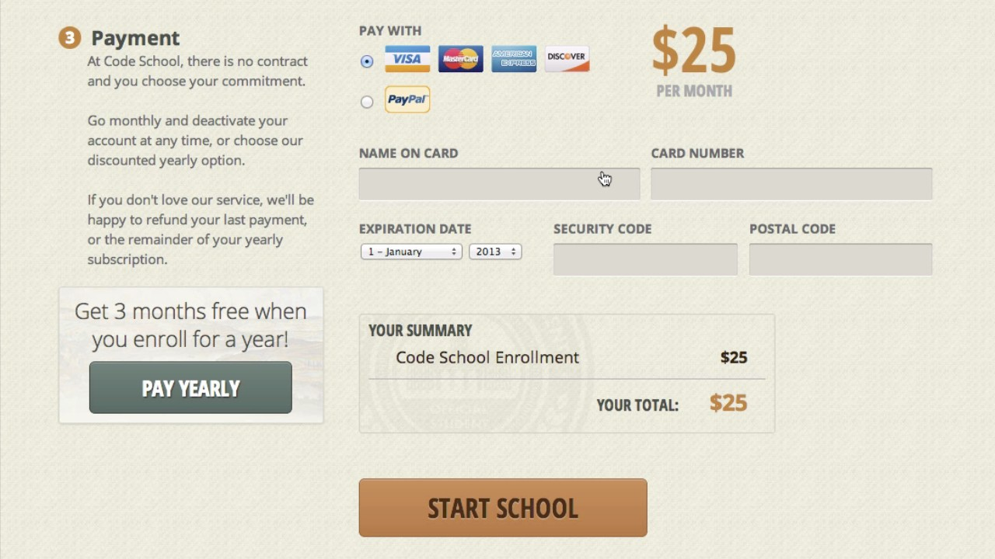
What you can do with jQuery
change content based on user actions
1.1 What is jQuery?

Slide 7
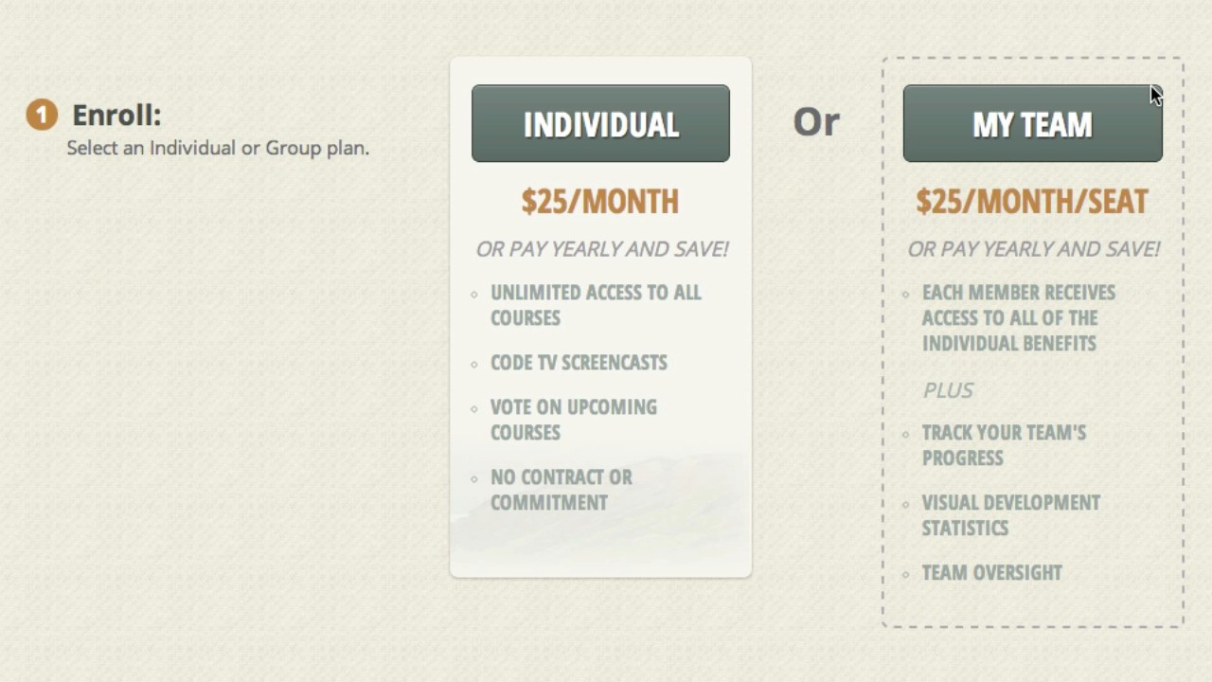
What you can do with jQuery
toggle CSS classes to highlight an element
1.1 What is jQuery?

Slide 8




jQuery makes it easy to:
find
elements in an HTML document
change
HTML content
listen
to what a user does and react accordingly
animate
content on the page
talk
over the network to fetch new content
1.1 What is jQuery?

Slide 9



Changing content
HTML document
<!DOCTYPE
<html>
<head>
html>
How can we modify the text of the <h1> element?
<title>jQuery
</head>
<body>
Adventures</title>
find it
<h1>Where do
you want to go?</h1> next adventure.</p>
change it
<p>Plan
</body>
</html>
your
1.1 What is jQuery?

Slide 10


Finding the proper HTML
HTML document
<!DOCTYPE
<html>
<head>
html>
find it
How can we search through our html?
<title>jQuery
</head>
<body>
Adventures</title>
<h1>Where do
you want to go?</h1> next adventure.</p>
<p>Plan
</body>
</html>
your
We need to understand how our browser organizes the HTML it receives.
1.1 What is jQuery?

Slide 11

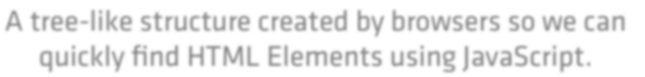

Document Object Model
A tree-like structure created by browsers so we can
quickly find HTML Elements using JavaScript.
“DOM”
1.1 What is jQuery?

Slide 12


Loading HTML into the DOM
HTML document
<!DOCTYPE
<html>
<head>
html>
<title>jQuery
</head>
<body>
Adventures</title>
browser
50%
DOM
<h1>Where do you
want to go?</h1>
0%
100%
<p>Plan
</body>
</html>
your next adventure.</p>
1.1 What is jQuery?

Slide 13

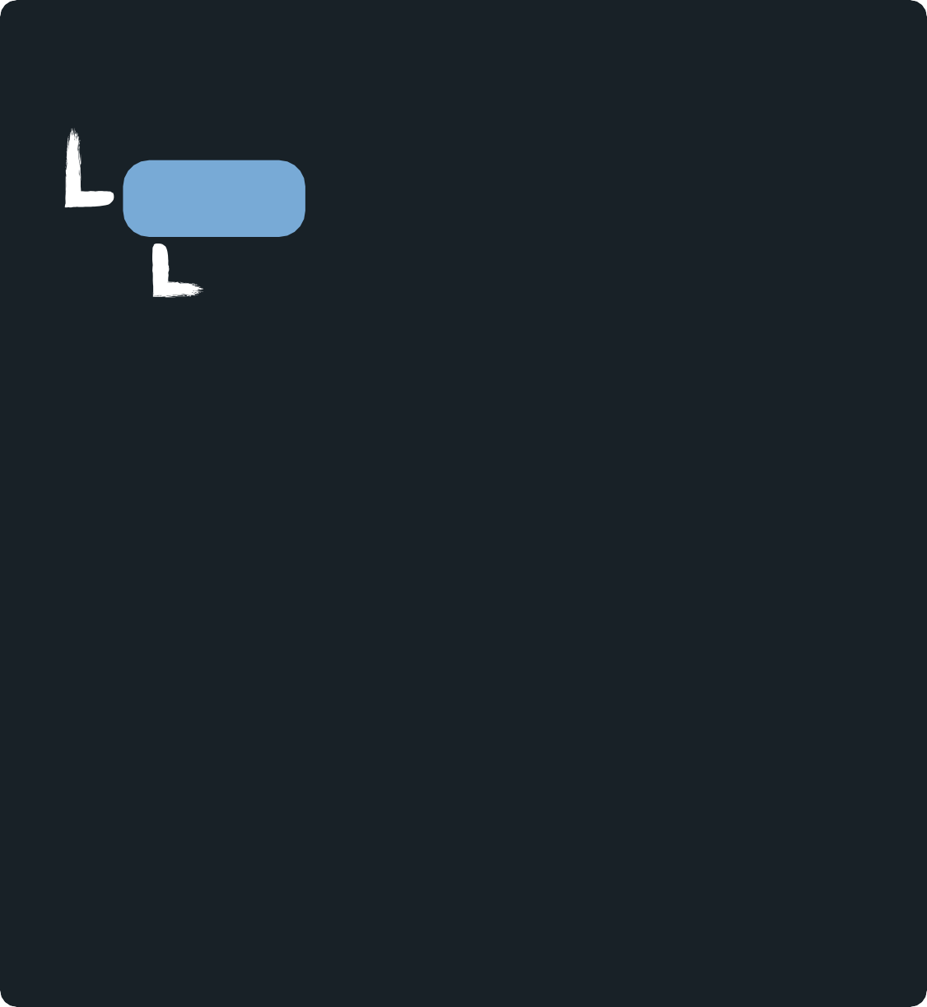









What does that DOM structure look like?
The DOM
HTML document
<!DOCTYPE
<html>
<head>
html>
DOCUMENT
html
head
title
jQuery
body
h1
<title>jQuery
</head>
<body>
Adventures</title>
<h1>Where do you
want to go?</h1>
Adven...
<p>Plan
</body>
</html>
your next adventure.</p>
Where
do...
Inside the DOM, HTML elements become “nodes” which have relationships with one another.
p
Plan
your...
node types:
element
text
1.1 What is jQuery?

Slide 14










How do we search through the DOM?
The DOM
DOCUMENT
html
head
title
jQuery
body
h1
JavaScript
JavaScript gives developers a language to interact with the DOM.
Adven...
Where
do...
p
Plan
your...
node types:
element
text
1.1 What is jQuery?

Slide 15













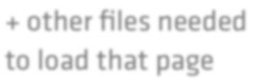

How do we find things using the DOM?
Web Server
Web Browser
Requests a Webpage
Loads into
DOM
Sends the HTML
HTML
HTML
+ other files needed to load that page
Interacts with
JavaScript
JavaScript
1.1 What is jQuery?

Slide 16









Of course, there’s a catch
DOM
each browser has a slightly diÇerent DOM interface
DOM
DOM
DOM
JavaScript
DOM
1.1 What is jQuery?

Slide 17





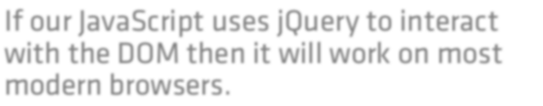
jQuery to the rescue!
DOM
DOM DOM
JavaScript
DOM
If our JavaScript uses jQuery to interact
with the DOM then it will work on most modern browsers.
DOM
1.1 What is jQuery?

Slide 18



Basic jQuery usage
this is the jQuery function
jQuery(<code>);
JavaScript
1.1 What is jQuery?

Slide 19



How jQuery Accesses The DOM
The DOM
jQuery( document);
JavaScript
But how can we search through the DOM?
1.1 What is jQuery?

Slide 20




We need to use CSS selectors
HTML document
<!DOCTYPE
<html>
<head>
html>
CSS selectors
h1 { font-size:
3em; }
<title>jQuery
</head>
<body>
Adventures</title>
p { color:
blue; }
<h1>Where do you
want to go?</h1>
<p>Plan
</body>
</html>
your next adventure.</p>
1.1 What is jQuery?

Slide 21




Using the jQuery function to find nodes
HTML document jQuery selectors
=
<!DOCTYPE
<html>
<head>
html>
jQuery("h1");
$("h1");
<title>jQuery
</head>
<body>
Adventures</title>
jQuery("p");
$("p");
short & sweet syntax
<h1>Where do you
want to go?</h1>
<p>Plan
</body>
</html>
your next adventure.</p>
1.1 What is jQuery?

Slide 22
Changing the content of an element
HTML document
<!DOCTYPE
<html>
<head>
html>
How can we modify the text of the <h1> element?
<title>jQuery
</head>
<body>
Adventures</title>
find it
<h1>Where do you
want to go?</h1>
change it
<p>Plan
</body>
</html>
your next adventure.</p>
1.1 What is jQuery?

Slide 23

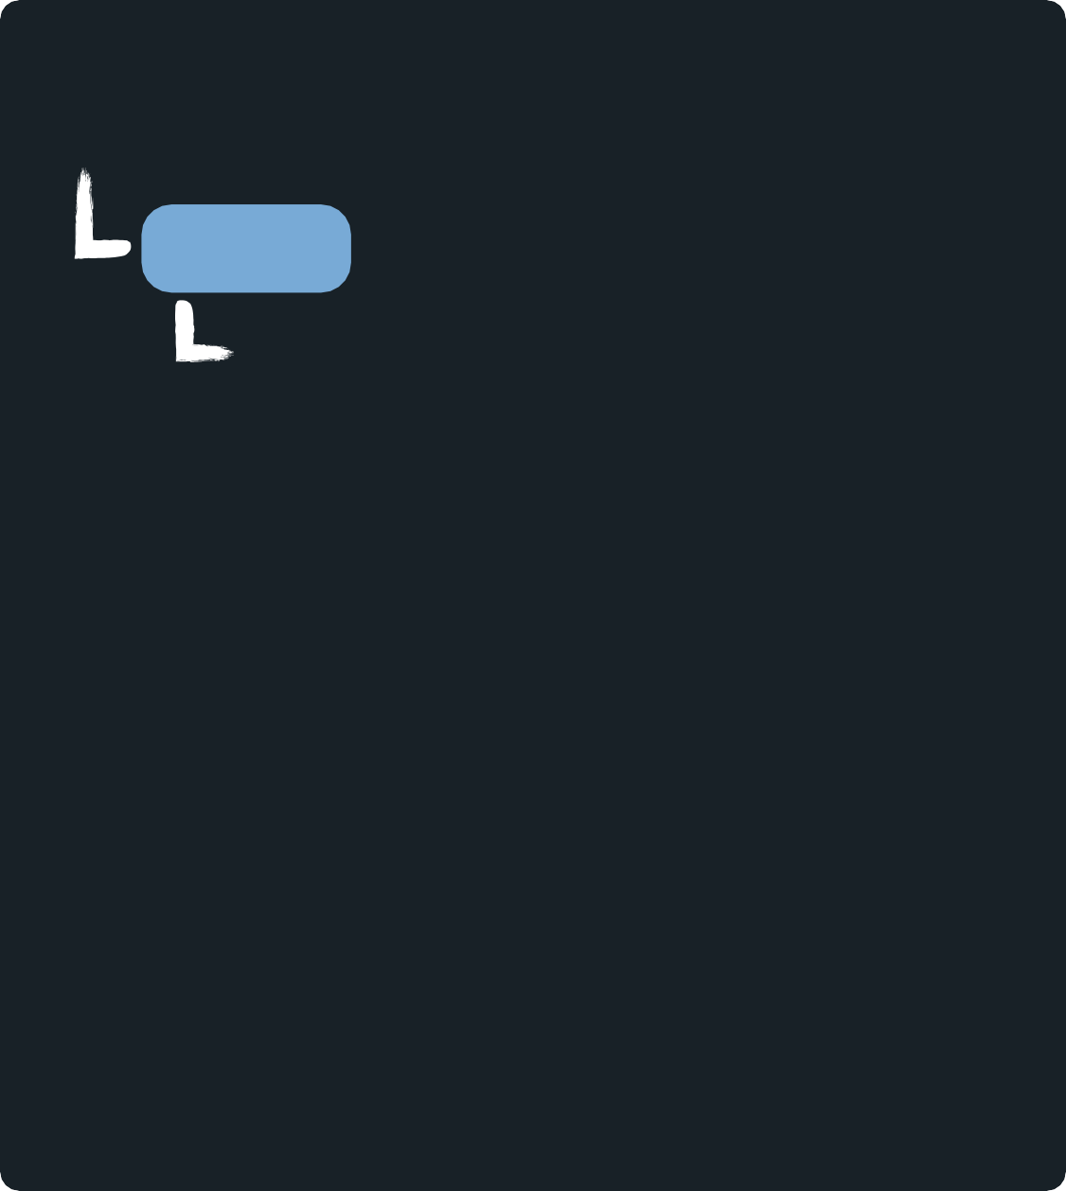

Selecting by HTML element name
DOM representation of the document
HTML document
<!DOCTYPE
<html>
<head>
html>
DOCUMENT
html
head
title
jQuery Adv...
body
h1
Where
p
<title>jQuery
</head>
<body>
Adventures</title>
<h1>Where do you
want to go?</h1>
<p>Plan
</body>
</html>
your next adventure.</p>
do...
Plan
your...
1.1 What is jQuery?

Slide 24


Selecting by HTML element name
DOM representation of the document
DOCUMENT
html
$("h1");
head
title
jQuery Adv...
body
h1
Where
p
do...
Plan
your...
1.1 What is jQuery?

Slide 25




Fetching an element’s text
DOM representation of the document
text() is a method offered by jQuery
DOCUMENT
html
head
$("h1").text();
"Where do you
want
to go"
title
jQuery Adv...
body
h1
Where
p
do...
Plan
your...
1.1 What is jQuery?

Slide 26


Modifying an element’s text
DOM representation of the document
text() also allows to modify the text node
DOCUMENT
html
$("h1").text("Where
to?");
head
title
jQuery
body
h1
Adv...
Where to?
p
Plan
your...
1.1 What is jQuery?

Slide 27






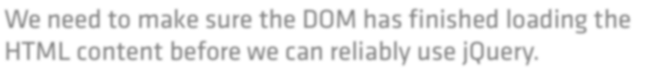

JavaScript may execute before the DOM loads
HTML DOM
0% 50% 100%
h1 wasn’t in the DOM yet!
$("h1").text("Where
to?");
We need to make sure the DOM has finished loading the HTML content before we can reliably use jQuery.
1.1 What is jQuery?

Slide 28





The DOM ready event
HTML
DOM
0%
50%
100%
“I’m ready!”
How can we listen for this signal?
Listen for “I’m ready” then run <code>
1.1 What is jQuery?

Slide 29




Listening for document ready
DOM
jQuery(document).ready(function(){
<code>
});
“I’m ready!”
Will only run this code once the DOM is “ready”
1.1 What is jQuery?

Slide 30

Our completed code
jQuery(document).ready(function(){
$("h1").text("Where to?");
});
1.1 What is jQuery?

Slide 31
Using jQuery

Slide 32


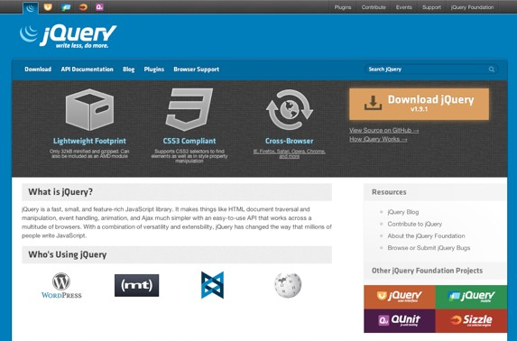


Getting started
1
download jQuery
2
load it in your HTML document
<script src="jquery.min.js"></script>
3
start using it
<script src="application.js"></script>
1.2 Using jQuery

Slide 33


Changing multiple elements at once
HTML document
How do we change the text of every <li> in this page?
find them
<h1>Where do you want to go?</h1>
<h2>Travel Destinations</h2>
<p>Plan your next adventure.</p>
<ul id="destinations">
<li>Rome</li>
<li>Paris</li>
<li class='promo'>Rio</li>
</ul>
modify their text
1.2 Using jQuery

Slide 34












Load HTML into the DOM
HTML document
<h1>Where do you want to go?</h1>
<h2>Travel Destinations</h2>
<p>Plan your next adventure.</p>
<ul id="destinations">
<li>Rome</li>
<li>Paris</li>
<li class='promo'>Rio</li>
</ul>
body
h1
Where
do...
h2
Plan
your...
ul
li
Rome
li
Paris
li
Rio
1.2 Using jQuery

Slide 35





Selecting multiple elements
HTML document
<h1>Where do you want to go?</h1>
<h2>Travel Destinations</h2>
<p>Plan your next adventure.</p>
<ul id="destinations">
<li>Rome</li>
<li>Paris</li>
<li class='promo'>Rio</li>
</ul>
body
h1
Where
do...
h2
Plan
your...
ul
li
Rome
li
Paris
li
Rio
$("li") ;
1.2 Using jQuery

Slide 36

Modifying each of their text nodes
HTML document
<h1>Where do you want to go?</h1>
<h2>Travel Destinations</h2>
<p>Plan your next adventure.</p>
<ul id="destinations">
<li>Rome</li>
<li>Paris</li>
<li class='promo'>Rio</li>
</ul>
body
h1
Where
do...
h2
Plan
your...
UL
Orlando
Orlando
$("li").text("Orlando");
Orlando
1.2 Using jQuery

Slide 37



We can find elements by ID or Class
CSS
jQuery
$("p");
p { ... }
#container
{ ... }
$("#container");
.articles
{ ... }
$(".articles");
1.2 Using jQuery

Slide 38

Changing multiple elements at once
HTML document
<h1>Where do you want to go?</h1>
<h2>Travel Destinations</h2>
<p>Plan your next adventure.</p>
<ul id="destinations">
<li>Rome</li>
<li>Paris</li>
<li class='promo'>Rio</li>
</ul>
How do we specifically select the <ul> that has a “destinations” ID?
find it using the ID
1.2 Using jQuery

Slide 39

Selecting by unique ID
HTML document
<h1>Where do you want to go?</h1>
<h2>Travel Destinations</h2>
<p>Plan your next adventure.</p>
<ul id="destinations">
<li>Rome</li>
<li>Paris</li>
<li class='promo'>Rio</li>
</ul>
body
h1
Where
do...
h2
Plan your...
ul id="destinations" li
Rome
li
Paris
$("#destinations");
li
class="promo" Rio
1.2 Using jQuery

Slide 40

Changing multiple elements at once
HTML document
<h1>Where do you want to go?</h1>
<h2>Travel Destinations</h2>
<p>Plan your next adventure.</p>
<ul id="destinations">
<li>Rome</li>
<li>Paris</li>
<li class='promo'>Rio</li>
</ul>
How can we select just the <li> that has a “promo” class attribute?
find it using the class
1.2 Using jQuery

Slide 41

Selecting by Class Name
HTML document
<h1>Where do you want to go?</h1>
<h2>Travel Destinations</h2>
<p>Plan your next adventure.</p>
<ul id="destinations">
<li>Rome</li>
<li>Paris</li>
<li class='promo'>Rio</li>
</ul>
body
h1
Where
do...
h2
Plan your...
ul id="destinations" li
Rome
li
Paris
$(".promo");
li
class="promo" Rio
1.2 Using jQuery

Slide 42
level2

Slide 43
Searching the DOM

Slide 44


Selecting descendants
HTML document
<h1>Where do you want to go?</h1>
<h2>Travel Destinations</h2>
<p>Plan your next adventure.</p>
<ul id="destinations">
<li>Rome</li>
<li>Paris</li>
<li class='promo'>Rio</li>
</ul>
How do we find the <li> elements that are inside of the <ul> with a “destinations” ID?
descendant selector
2.1 Searching the DOM

Slide 45




Using the descendant selector
HTML document
<h1>Where do you want to go?</h1>
<h2>Travel Destinations</h2>
<p>Plan your next adventure.</p>
<ul id="destinations">
<li>Rome</li>
<li>Paris</li>
<li class='promo'>Rio</li>
</ul>
body
h1
Where
do...
h2
Plan
your...
ul
li
Rome
li
Paris
li
Rio
the space matters
$("#destinations
li");
parent
descendant
2.1 Searching the DOM

Slide 46



Selecting direct children
HHTTMMLL ddooccuummeenntt
<h1>Where do you want to go?</h1>
<h2>Travel Destinations</h2>
<p>Plan your next adventure.</p>
<ul id="destinations">
<li>Rome</li>
<li>
<ul id="france">
<li>Paris</li>
</ul>
</li>
<li class='promo'>Rio</li>
</ul>
How do we find only the <li> elements that are children of the “destinations” <ul>?
descendant selector?
2.1 Searching the DOM

Slide 47






Selecting direct children
HTML document
<h1>Where do you want to go?</h1>
<h2>Travel Destinations</h2>
<p>Plan your next adventure.</p>
<ul id="destinations">
<li>Rome</li>
<li>
<ul id="france">
<li>Paris</li>
</ul>
</li>
<li class='promo'>Rio</li>
</ul>
body
...
ul
li
Rome
li
we don’t want this
ul
li
li
Paris
Rio
$("#destinations
li");
2.1 Searching the DOM

Slide 48


Selecting only direct children
HTML document
<h1>Where do you want to go?</h1>
<h2>Travel Destinations</h2>
<p>Plan your next adventure.</p>
<ul id="destinations">
<li>Rome</li>
<li>
<ul id="france">
<li>Paris</li>
</ul>
</li>
<li class='promo'>Rio</li>
</div>
How do we find only the <li> elements that are
direct children of the “destinations” <ul> then?
child selector
2.1 Searching the DOM

Slide 49





Selecting only direct children
HTML document
<h1>Where do you want to go?</h1>
<h2>Travel Destinations</h2>
<p>Plan your next adventure.</p>
<ul id="destinations">
<li>Rome</li>
<li>
<ul id="france">
<li>Paris</li>
</ul>
</li>
<li class='promo'>Rio</li>
</ul>
the sign matters
body
...
ul
li
Rome
li
not selected
ul
li
li
Paris
Rio
$("#destinations
> li");
parent
child

Slide 50

Selecting multiple elements
HTML document
<h1>Where do you want to go?</h1>
<h2>Travel Destinations</h2>
<p>Plan your next adventure.</p>
<ul id="destinations">
<li>Rome</li>
<li>
<ul id="france">
<li>Paris</li>
</ul>
</li>
<li class='promo'>Rio</li>
</ul>
How do we find only elements
with either a “promo” class or a “france” ID
multiple selector
2.1 Searching the DOM

Slide 51


Selecting multiple elements
HTML document
<h1>Where do you want to go?</h1>
<h2>Travel Destinations</h2>
<p>Plan your next adventure.</p>
<ul id="destinations">
<li>Rome</li>
<li>
<ul id="france">
<li>Paris</li>
</ul>
</li>
<li class='promo'>Rio</li>
</ul>
the comma matters
body
...
ul
li
Rome
li
ul
li
li
Paris
Rio
$(".promo,
#france");

Slide 52




CSS-like pseudo classes
$("#destinations
li:first");
body
h1
$("#destinations
li:last");
Where
do...
filter
h2
Plan
your...
ul
li
Rome
li
Paris
li
Rio
2.1 Searching the DOM

Slide 53







CSS-like pseudo classes
$("#destinations
li:odd");
body
h1
$("#destinations
li:even");
Where
do...
h2
Plan
your...
ul
li
Rome
li
Paris
li
Rio
#0
#1
! watch out, the index starts at 0
#2
2.1 Searching the DOM

Slide 54
Traversing

Slide 55


Walking the DOM by traversing it
HTML document
<h1>Where do you want to go?</h1>
<h2>Travel Destinations</h2>
<p>Plan your next adventure.</p>
<ul id="destinations">
<li>Rome</li>
<li>Paris</li>
<li class='promo'>Rio</li>
</ul>
Can we find all the <li> elements that
the “destinations” list contains without using a descendant selector?
filter by traversing
2.2 Traversing

Slide 56
















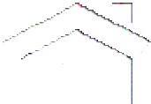



Filtering by traversing
$("#destinations
li");
body
h1
Where
do...
$("#destinations").find("li");
h2
Plan
your...
ul
li
Rome
li
Paris
li
Rio
selection
traversal
It takes a bit more code, but it’s faster.
2.2 Traversing

Slide 57


Filtering by traversing
$("li:first");
body
h1
Where
do...
$("li").first();
h2
Plan
your...
ul
li
Rome
li
Paris
li
Rio
2.2 Traversing

Slide 58



Filtering by traversing
$("li:last");
body
h1
Where
do...
$("li").last();
h2
Plan
your...
ul
li
Rome
li
Paris
li
Rio
2.2 Traversing

Slide 59



Walking the DOM
HTML document
<h1>Where do you want to go?</h1>
<h2>Travel Destinations</h2>
<p>Plan your next adventure.</p>
<ul id="destinations">
<li>Rome</li>
<li>Paris</li>
<li class='promo'>Rio</li>
</ul>
Can we find the middle list item, knowing there is no filter to find it unlike :first or :last?
traversing
2.2 Traversing

Slide 60

Walking the DOM
$("li").first();
body
h1
Where
do...
h2
Plan
your...
ul
li
Rome
li
Paris
li
Rio
2.2 Traversing

Slide 61


Walking the DOM
$("li").first();
$("li").first().next();
body
h1
Where
do...
h2
Plan
your...
ul
li
Rome
li
Paris
li
Rio
2.2 Traversing

Slide 62


Walking the DOM
$("li").first();
$("li").first().next();
body
h1
Where
do...
h2
Plan
your...
$("li").first().next().prev();
ul
li
Rome
li
Paris
li
Rio
2.2 Traversing

Slide 63



Walking up the DOM
HTML document
<h1>Where do you want to go?</h1>
<h2>Travel Destinations</h2>
<p>Plan your next adventure.</p>
<ul id="destinations">
<li>Rome</li>
<li>Paris</li>
<li class='promo'>Rio</li>
</ul>
If we started by selecting a child, can we figure out what element is its direct parent?
traversing up
2.2 Traversing

Slide 64

Walking up the DOM
$("li").first();
body
h1
Where
do...
h2
Plan
your...
ul
li
Rome
li
Paris
li
Rio
2.2 Traversing

Slide 65
Walking up the DOM
$("li").first();
$("li").first().parent();
body
h1
Where
do...
h2
Plan
your...
ul
li
Rome
li
Paris
li
Rio
2.2 Traversing

Slide 66



Walking down the DOM
HTML document
<h1>Where do you want to go?</h1>
<h2>Travel Destinations</h2>
<p>Plan your next adventure.</p>
<ul id="destinations">
<li>Rome</li>
<ul id="france">
<li>Paris</li>
</ul>
<li class='promo'>Rio</li>
</ul>
With a parent that has many children who in
turn have their own children, how could we find only the first generation of children?
traversing down
2.2 Traversing

Slide 67







Walking the DOM up and down
$("#destinations").children("li");
body
...
ul
children(), unlike find(), only selects direct children
id="destinations"
li
Rome
li
ul
li
li
Paris
Rio
2.2 Traversing

Slide 68
level3

Slide 69
Working with the DOM

Slide 70
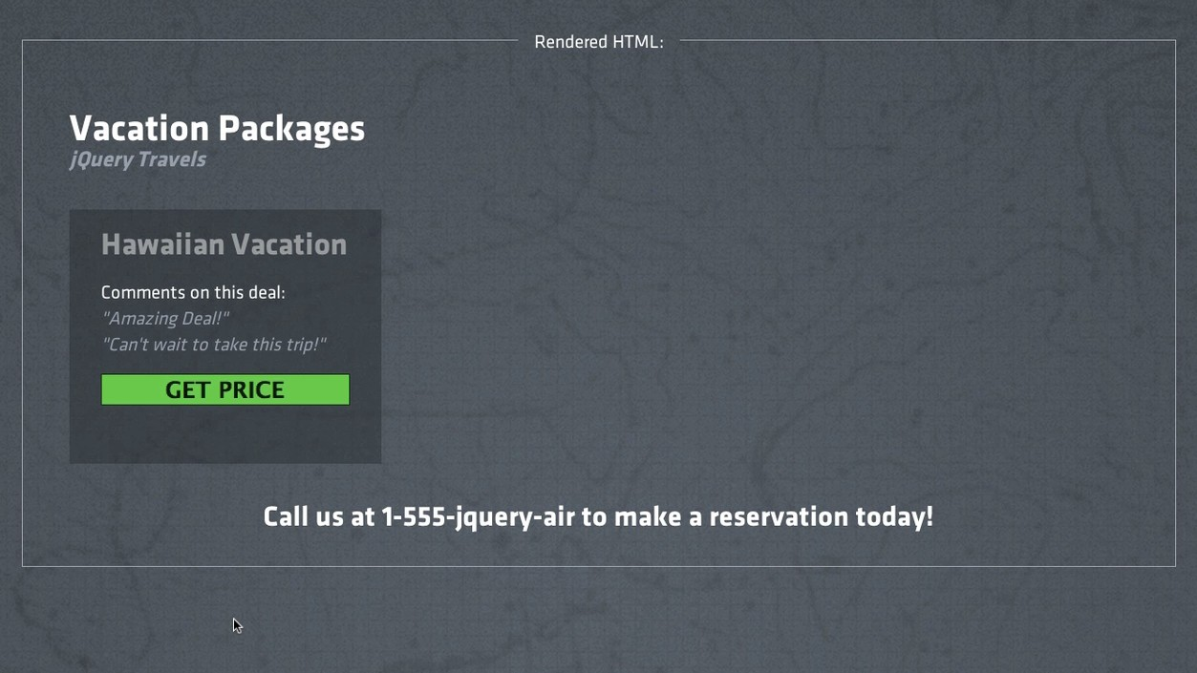
3.1 Manipulating the DOM

Slide 71









Appending to the DOM
DOM representation of the document
1
append a new DOM node
DOCUMENT
li class="vacation" h2
2
remove a DOM node
Hawaiian button
Vac...
Get Price
p
$399.99
3.1 Manipulating the DOM

Slide 72










Appending to the DOM
application.js
DOCUMENT
$(document).ready(function() {
// create a <p> node with
});
the price
li class="vacation"
h2
Hawaiian button
Vac...
var price
= "From
$399.99";
Get Price
Price node (not in the DOM yet)
var price
= "<p>From
$399.99</p>";
p
var price
= $('<p>From $399.99</p>');
Creates a node but doesn’t add it to the DOM
$399.99
3.1 Manipulating the DOM

Slide 73
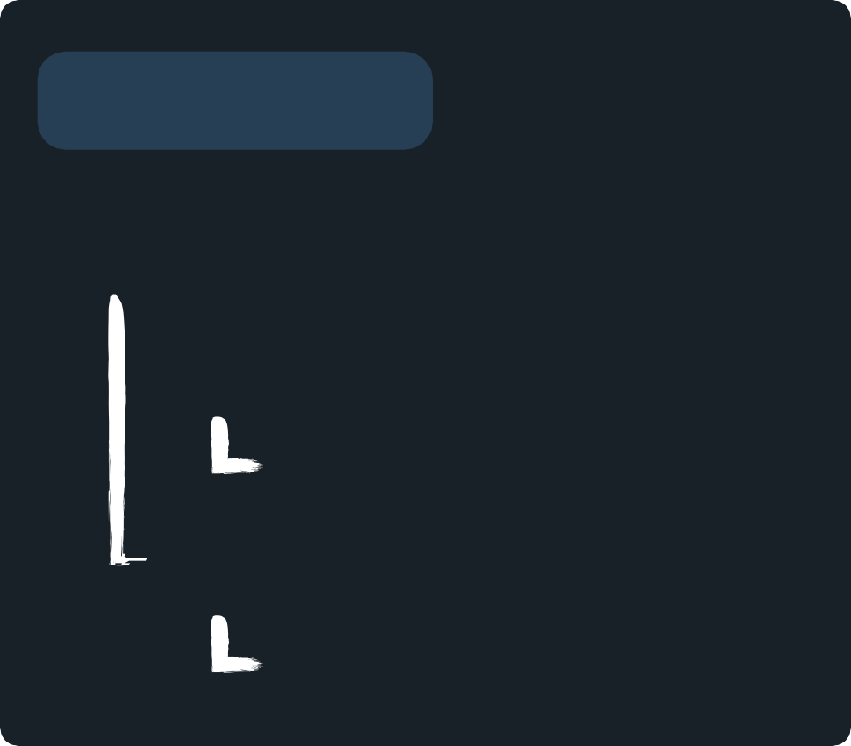




Appending to the DOM
application.js
DOCUMENT
$(document).ready(function() {
var price = $('<p>From
});
$399.99</p>');
li class="vacation"
h2
ways to add this price node to the DOM
Hawaiian button
Vac...
Get Price
Price node (not in the DOM yet)
.append(<element>)
.prepend(<element>)
.after(<element>)
.before(<element>)
p
$399.99
3.1 Manipulating the DOM

Slide 74



Before
application.js
DOCUMENT
$(document).ready(function() {
var price = $('<p>From $399.99</p>');
$('.vacation').before(price);
});
p
$399.99
li class="vacation"
Puts the price node before .vacation
h2
Hawaiian button
Vac...
Get Price
3.1 Manipulating the DOM

Slide 75

After
application.js
DOCUMENT
$(document).ready(function() {
var price = $('<p>From $399.99</p>');
$('.vacation').after(price);
});
li class="vacation"
h2
Hawaiian button
Vac...
Puts the price node after .vacation
Get Price
p
$399.99
3.1 Manipulating the DOM

Slide 76

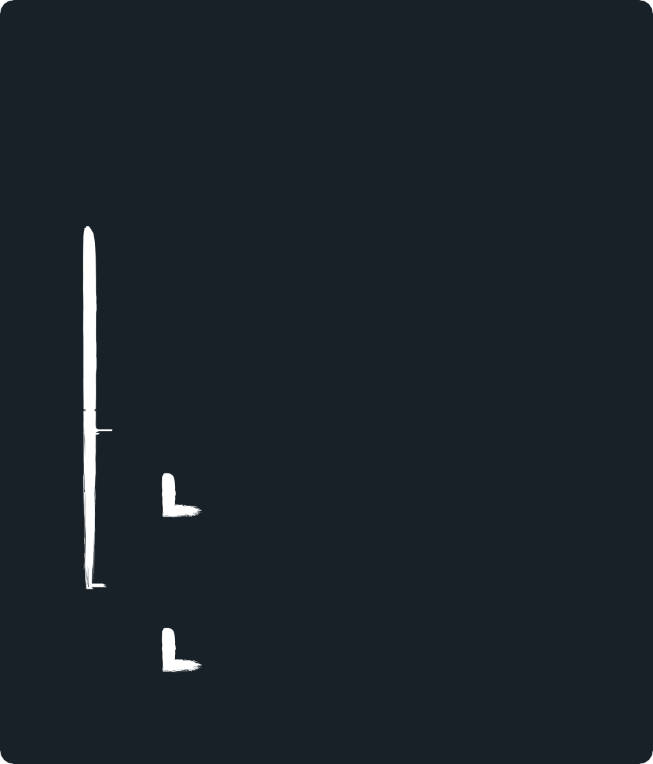

Prepend
application.js
DOCUMENT
$(document).ready(function() {
var price = $('<p>From $399.99</p>');
$('.vacation').prepend(price);
});
li class="vacation"
p
$399.99
Adds the node to the top of .vacation
h2
Hawaiian button
Vac...
Get Price
3.1 Manipulating the DOM

Slide 77

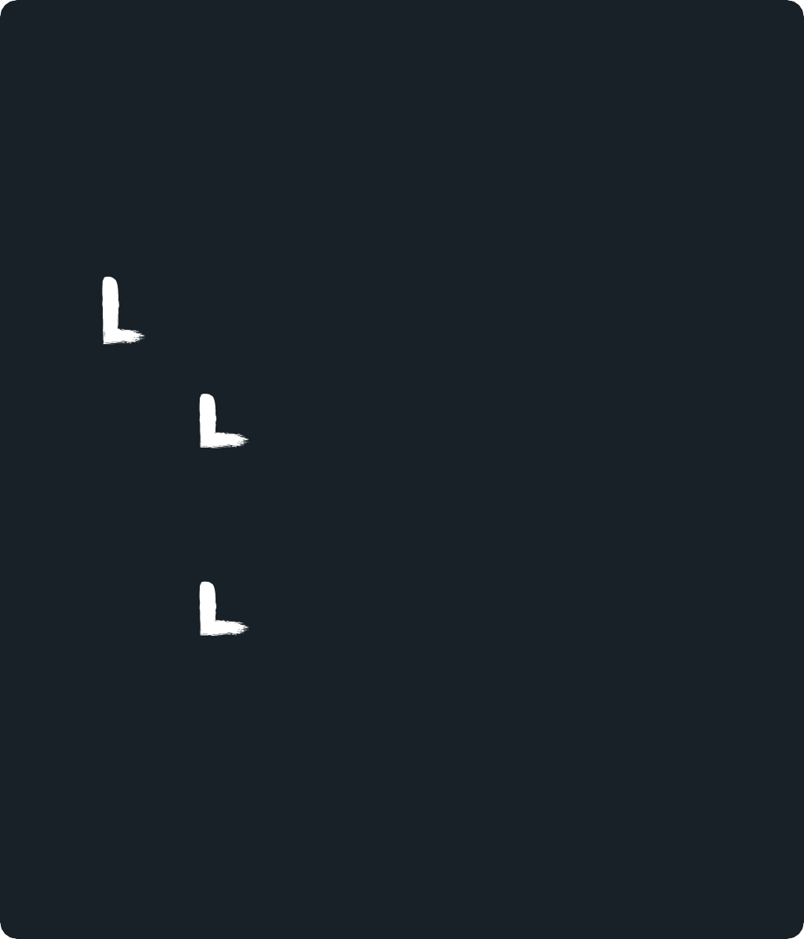

Prepend and Append
$(document).ready(function() {
var price = $('<p>From $399.99</p>');
$('.vacation').append(price);
});
Puts the price node at the bottom of .vacation
application.js
DOCUMENT
li class="vacation"
h2
Hawaiian button
Vac...
Get Price
p
$399.99
3.1 Manipulating the DOM

Slide 78




Removing from the DOM
$(document).ready(function() {
var price = $('<p>From $399.99</p>');
$('.vacation').append(price);
$('button').remove();
});
Removes the <button> from the DOM
application.js
DOCUMENT
li class="vacation"
h2
Hawaiian button
Vac...
Get Price
p
$399.99
3.1 Manipulating the DOM

Slide 79
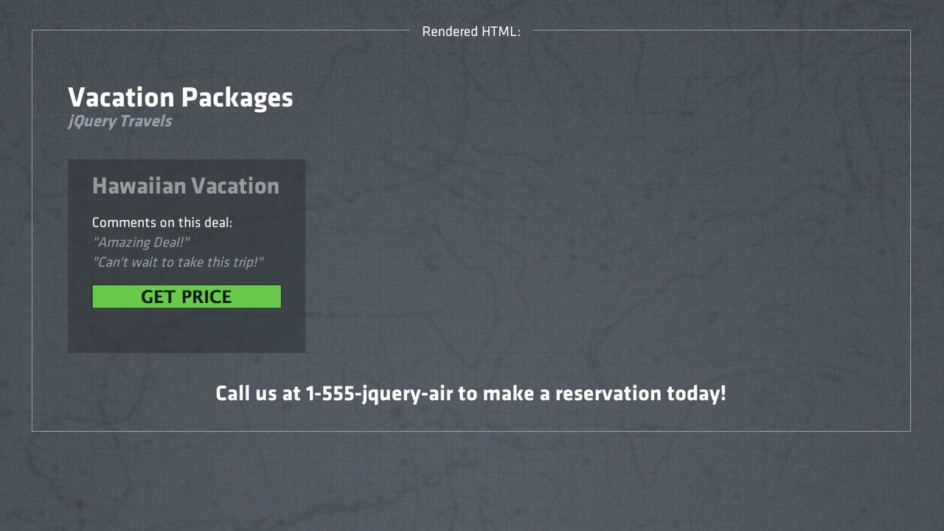
3.1 Manipulating the DOM

Slide 80



Appending to the DOM
application.js
DOCUMENT
$(document).ready(function() {
var price = $('<p>From $399.99</p>');
$('.vacation').append(price);
$('button').remove();
li class="vacation"
h2
Hawaiian button
});
Vac...
Appends in the same place
.appendTo(<element>)
.prependTo(<element>)
Get Price
Price node (not in the DOM yet)
.insertAfter(<element>)
.insertBefore(<element>)
p
$399.99
price.appendTo($('.vacation'));
3.1 Manipulating the DOM

Slide 81
Acting on Interaction

Slide 82



Passing in a function
$(document).ready(<event handler function>);
The ready method takes an event handler function as argument
function() {
// executing
//
the function
runs
the code
between
the braces
}
We create a function with the function keyword
$(document).ready(function() {
// this function runs when the
});
DOM is ready
And we pass this function as an argument to the ready method.
3.2 Acting on Interaction

Slide 83
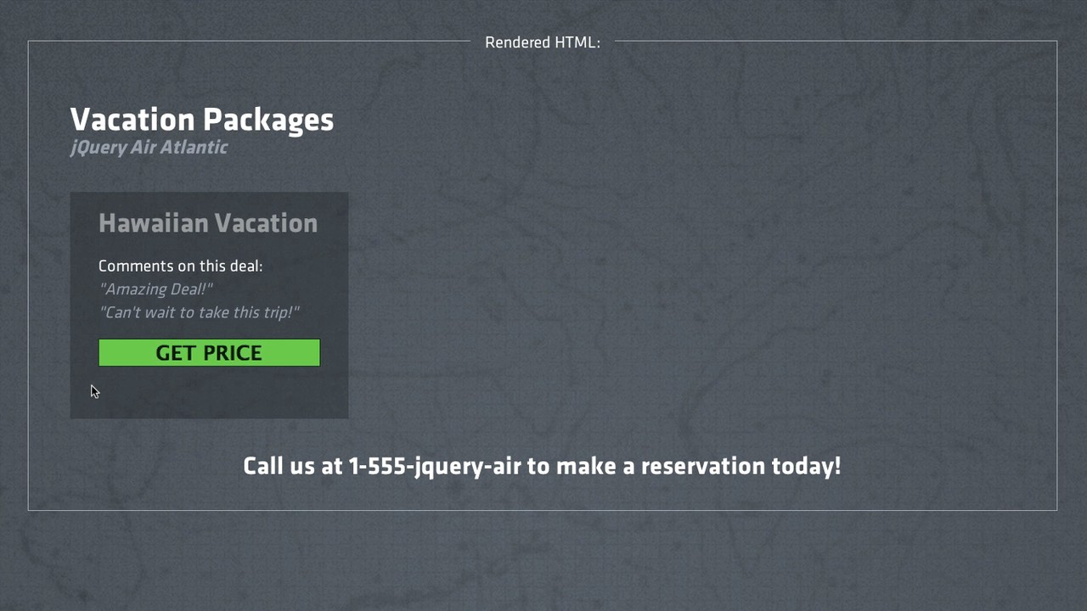
3.2 Acting on Interaction

Slide 84










Watching for Click
application.js
DOCUMENT
$(document).ready(function() {
// runs when the DOM is
});
ready
li
class="vacation"
h2
Hawaiian
Vacation
Target all buttons
Watch for any clicks
button
Get Price
$('button').on('click', function()
{
// runs when any button is
});
clicked
jQuery Object Methods
.on(<event>, <event
handler>)
Run the code inside of this function
3.2 Acting on Interaction

Slide 85



Removing from the DOM
application.js
runs when the DOM is ready
DOCUMENT
$(document).ready(function() {
$('button').on('click', function() {
li
class="vacation"
// run this function on click
});
});
h2
Hawaiian
Vacation
button
runs when a button is clicked
Get Price
3.2 Acting on Interaction

Slide 86



Removing from the DOM
var price = $('<p>From $399.99</p>');
$('.vacation').append(price);
$('button').remove();
});
});
application.js
DOCUMENT
$(document).ready(function() {
$('button').on('click',
function() {
li
class="vacation"
h2
Hawaiian
Vacation
button
Get Price
p
$399.99
3.2 Acting on Interaction

Slide 87
Now the price will be shown when we click the button

Slide 88
Refactor using Traversing

Slide 89
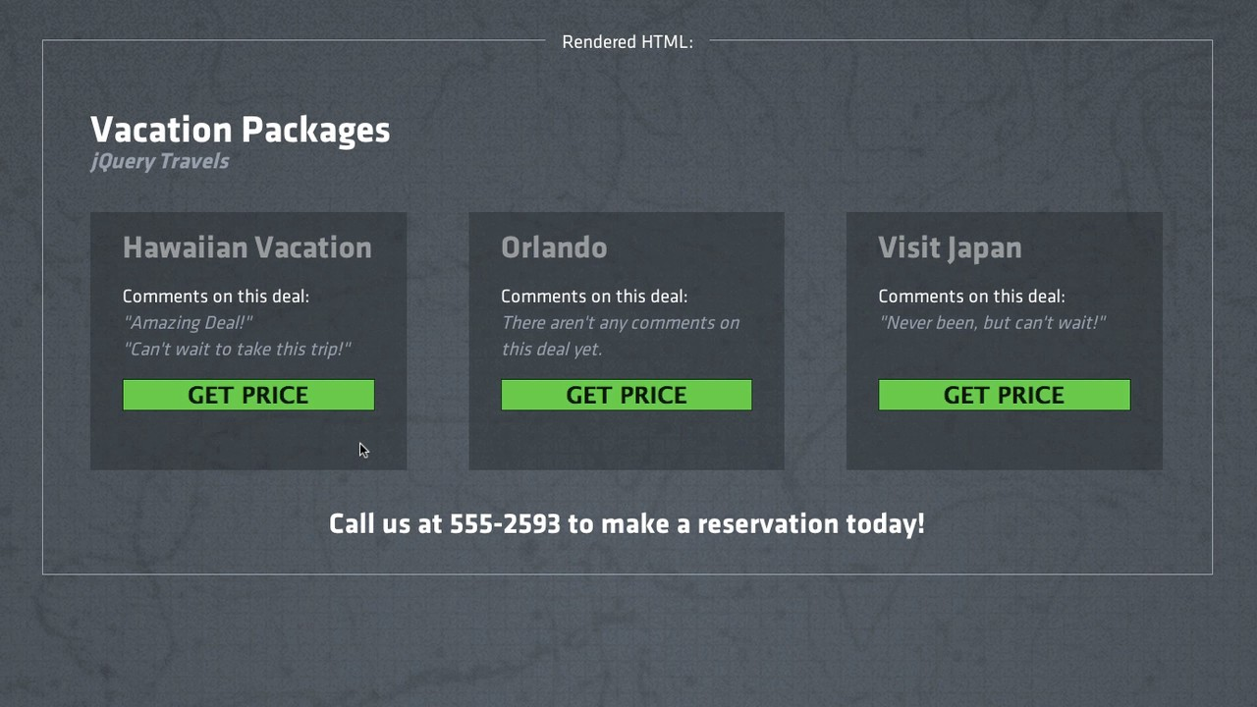
What if there are multiple vacation packages?

Slide 90














Working, but with Errors
application.js
DOCUMENT
$(document).ready(function() {
$('button').on('click', function() {
div
id="vacations"
var price = $('<p>From $399.99</p>');
$('.vacation').append(price);
$('button').remove();
ul
li
class="vacation"
});
});
button p
li
class="vacation"
Every button will be removed
button
p
The price will be appended to both .vacation elements
3.3 Refactor Using Traversing

Slide 91




An Introduction to $(this)
application.js
DOCUMENT
$(document).ready(function() {
$('button').on('click', function() {
div
id="vacations"
var price = $('<p>From $399.99</p>');
$('.vacation').append(price);
$('button').remove();
ul
li
class="vacation"
});
});
button p
If clicked, the button will be ‘this’
li
class="vacation"
this.remove();
button
Not a jQuery object, needs to be converted
p
$(this).remove();
3.3 Refactor Using Traversing

Slide 92

An Introduction to $(this)
application.js
DOCUMENT
$(document).ready(function() {
$('button').on('click', function() {
div
id="vacations"
var price = $('<p>From $399.99</p>');
$('.vacation').append(price);
ul
$(this).remove();
li
class="vacation"
});
});
button p
Only removes whichever button was clicked
li
class="vacation"
button
p
3.3 Refactor Using Traversing

Slide 93
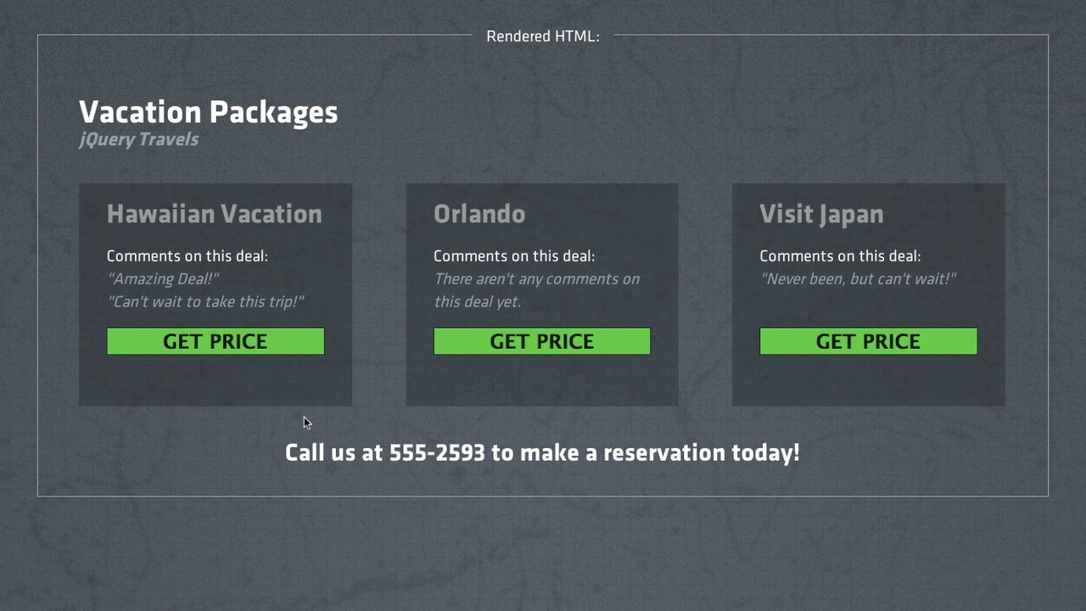
The clicked button will now be removed

Slide 94





Traversing from $(this)
application.js
DOCUMENT
$(document).ready(function() {
$('button').on('click', function() {
ul
var price = $('<p>From $399.99</p>');
$('.vacation').append(price);
class="vacation" h2
Hawaiian Vac... button
Get Price
li
$(this).remove();
});
});
$(this).after(price);
Adds the <p> node after the <button>
p
$399.99
3.3 Refactor Using Traversing

Slide 95

Traversing from $(this)
application.js
DOCUMENT
$(document).ready(function() {
$(this).remove();
});
});
Add the price as a sibling after button
$('button').on('click', function() {
ul
var price = $('<p>From $399.99</p>');
class="vacation" h2
Hawaiian Vac... button
Get Price
li
$(this).after(price);
p
$399.99
3.3 Refactor Using Traversing

Slide 96









What if the button is moved?
application.js
$(document).ready(function() {
$('button').on('click', function() {
DOCUMENT
ul
var price = $('<p>From $399.99</p>');
class="vacation" h2
Hawaiian Vac... div
li
$(this).after(price);
$(this).remove();
});
});
If the button is moved, the price will be moved
button
Get Price
How do we keep the price as a child of <li>?
p
$399.99
3.3 Refactor Using Traversing

Slide 97


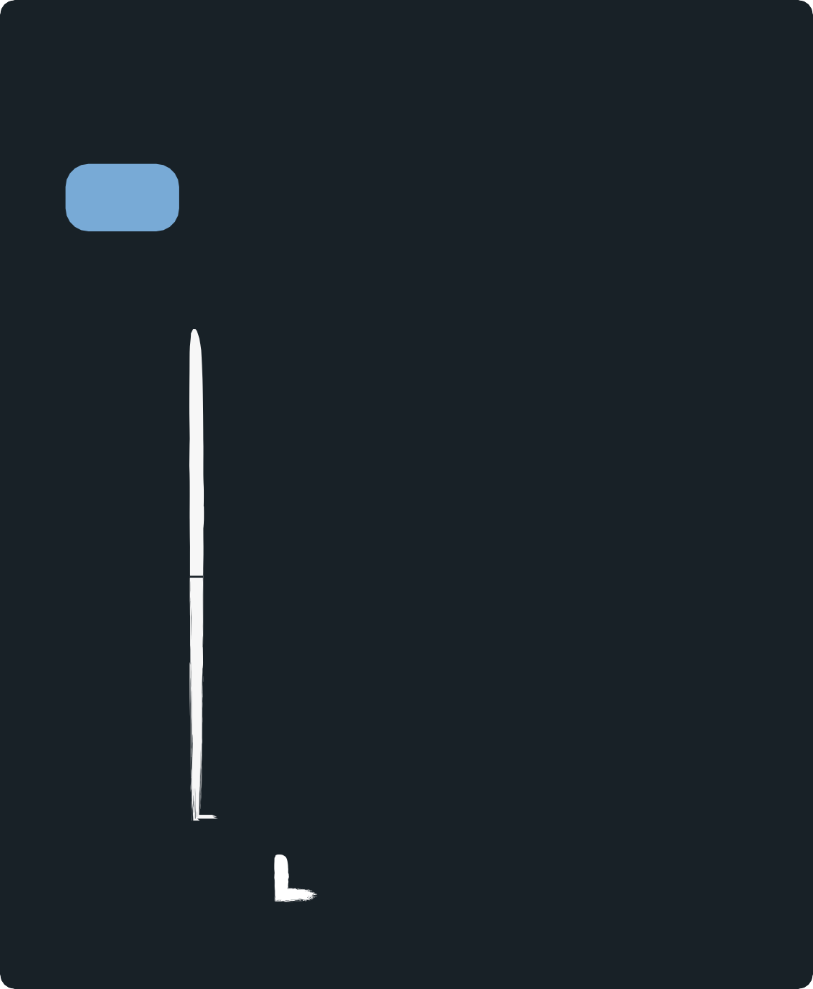


Using .closest(<selector>)
application.js
$(this).after(price);
$(this).parent().parent().append(price);
$(this).parents('.vacation').append(price);
$(this).closest('.vacation').append(price);
DOCUMENT
ul
class="vacation" h2
Hawaiian Vac... div
li
button
Get Price
p
$399.99
3.3 Refactor Using Traversing

Slide 98




Our Finished Handler
application.js
DOCUMENT
$(document).ready(function() {
$('button').on('click', function() {
ul
var price = $('<p>From $399.99</p>');
class="vacation" h2
Hawaiian Vac... button
Get Price
$(this).closest('.vacation').append(price);
li
$(this).remove();
});
});
Adds the <p> node at the bottom of .vacation
p
$399.99
3.3 Refactor Using Traversing

Slide 99
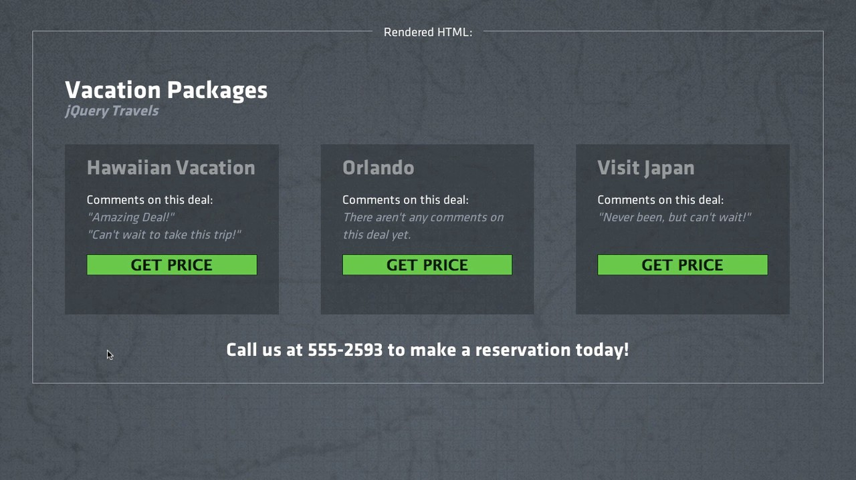
The prices will be added at the right place

Slide 100
Traversing and Filtering

Slide 101
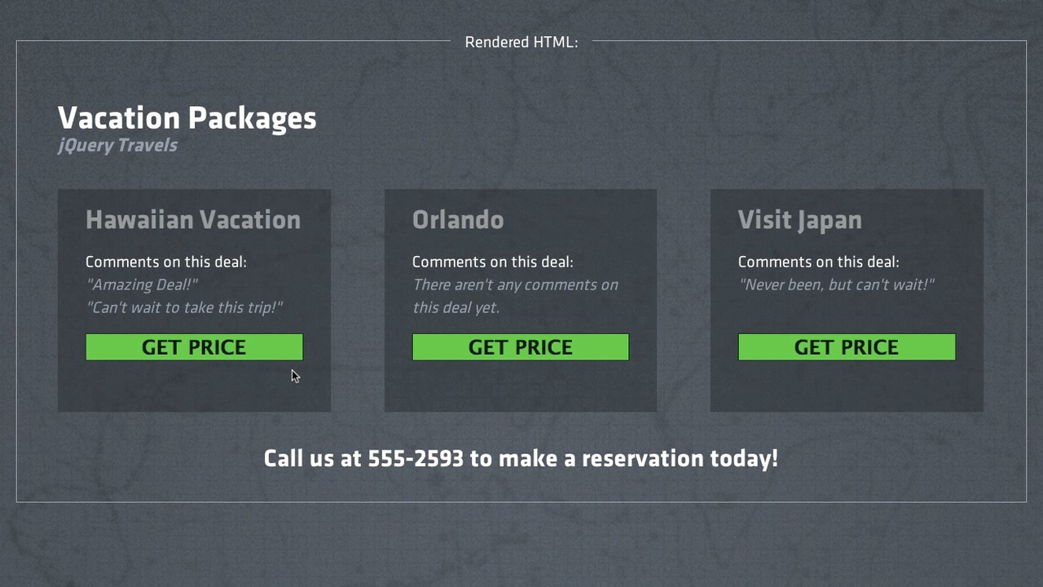
How do we allow vacations to have diferent prices?

Slide 102






Tackling the HTML
index.html
<li class="vacation onsale" data-price='399.99'>
<h3>Hawaiian Vacation</h3>
<button>Get Price</button>
<ul class='comments'>
<li>Amazing
<li>Want to
</ul>
deal!</li> go!</li>
</li>
All data attributes begin with ‘data-’
$('.vacation').first().data('price'); "399.99"
jQuery Object Methods
.data(<name>)
.data(<name>,
<value>)
3.4 Traversing & Filtering

Slide 103





Refactoring ‘Get Price’
application.js
$(document).ready(function() {
$('button').on('click', function() {
$(this).closest('.vacation').append(price);
$(this).remove();
});
});
Reads from the data-price attribute
var price = $('<p>From $399.99</p>');
var amount var
= $(this).closest('.vacation').data('price');
price
= $('<p>From $'+amount+'</p>');
Joins two strings to create the price
3.4 Traversing & Filtering

Slide 104


Refactoring ‘Get Price’
application.js
$(document).ready(function() {
$('button').on('click', function() {
var amount = $(this).closest('.vacation').data('price'); var price = $('<p>From $'+amount+'</p>');
$(this).closest('.vacation').append(price);
$(this).remove();
});
});
Each vacation can have its own price
3.4 Traversing & Filtering

Slide 105



Reusing jQuery Objects
application.js
$(document).ready(function() {
$('button').on('click', function() {
var amount = $(this).closest('.vacation').data('price'); var price = $('<p>From $'+amount+'</p>');
$(this).closest('.vacation').append(price);
$(this).remove();
});
});
var vacation var amount =
= $(this).closest('.vacation');
vacation.data('price');
vacation.append(price);
3.4 Traversing & Filtering

Slide 106


Reusing jQuery Objects
application.js
$(document).ready(function() {
$('button').on('click', function() {
var vacation = var amount = var
$(this).closest('.vacation');
vacation
.data('price');
price = $('<p>From
$'+amount+'</p>');
vacation
.append(price);
$(this).remove();
});
});
We’ll only query the DOM once for this element
3.4 Traversing & Filtering

Slide 107
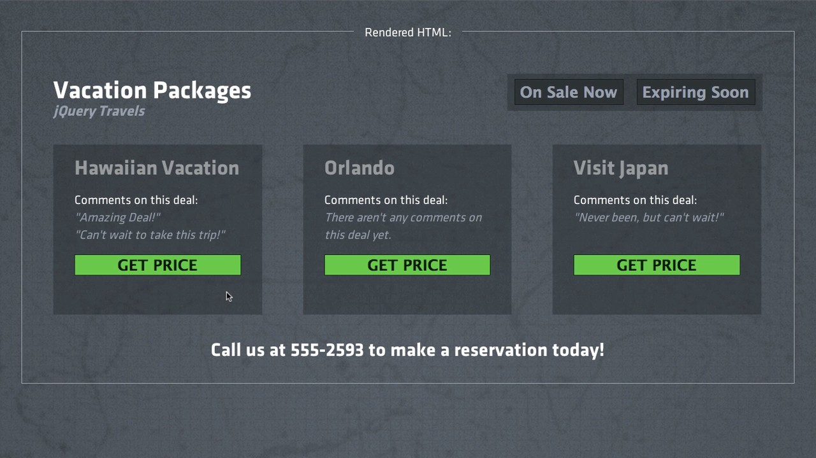
Each vacation can have its dynamic own price now

Slide 108





On With a Selector
application.js
$(document).ready(function() {
$('button').on('click',
...
});
function() {
});
If we add new buttons anywhere, they will trigger this click handler
$('.vacation
button').on('click',
function()
{});
$('.vacation').on('click',
'button',
function()
{});
Only target a ‘button’
if it’s inside a ‘.vacation’
3.4 Traversing & Filtering

Slide 109
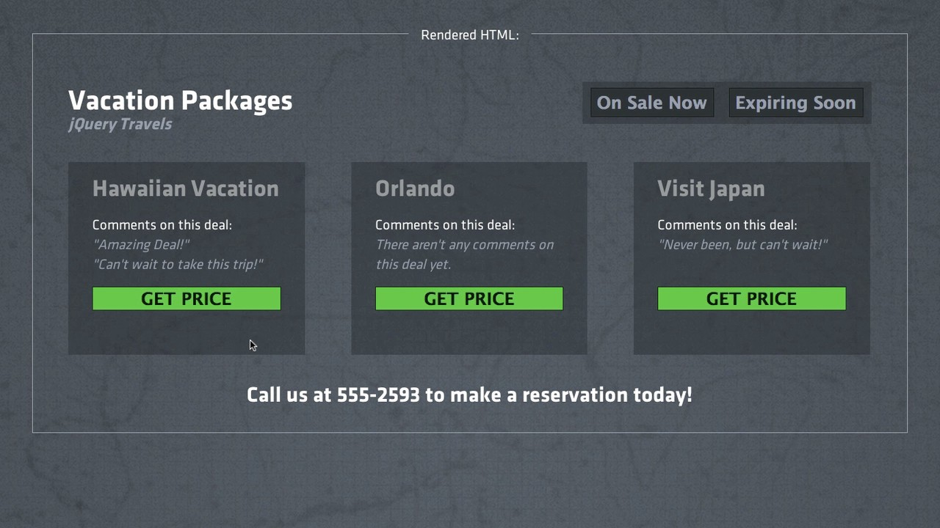
We’ll implement our new filters next

Slide 110


Filtering HTML
index.html
<div id='filters'>
...
<button
<button
...
</div>
class='onsale-filter'>On Sale Now</button> class='expiring-filter'>Expiring</button>
We’ll write 2 event handlers for our buttons
We’ll highlight vacations with these traits
3.4 Traversing & Filtering

Slide 111




Filtering for Vacations On sale
application.js
$('#filters').on('click', '.onsale-filter',
function() {
DOCUMENT
div
id="filters"
// find all vacations
//
});
that are on-sale
button
class="onsale-filter"
add a class to these
vacations
button
class="expiring-filter"
3.4 Traversing & Filtering

Slide 112









Filtering for Vacations On sale
application.js
$('#filters').on('click', '.onsale-filter',
function() {
DOCUMENT
ul
// find all vacations
//
});
that are on-sale
li
class="vacation onsale"
add a class to these
vacations
ul class="comments"
li li
$('.vacation.onsale')
li
class="vacation"
li class="vacation"
$('.vacation').filter('.onsale')
Finds elements with a class of .vacation and .onsale
3.4 Traversing & Filtering

Slide 113


Filtering for Vacations On sale
application.js
$('#filters').on('click', '.onsale-filter',
function() {
DOCUMENT
ul
$('.vacation').filter('.onsale')
// add a class to these vacations
});
li
class="vacation onsale"
ul class="comments"
li li
Class Manipulation
.addClass(<class>)
.removeClass(<class>)
li
class="vacation"
li class="vacation"
$('.vacation').filter('.onsale').addClass('highlighted');
3.4 Traversing & Filtering

Slide 114




Filtering for Vacations On sale
application.js
$('#filters').on('click', '.onsale-filter',
function() {
$('.vacation').filter('.onsale').addClass('highlighted');
});
Finds only the right vacations Adds a class of ‘highlighted’
The same can be done for our expiring filter
$('#filters').on('click', '.expiring-filter', function() {
$('.vacation').filter('.expiring').addClass('highlighted');
});
3.4 Traversing & Filtering

Slide 115

How do we make sure not all vacations are highlighted?

Slide 116



Unhighlighting Vacations
application.js
$('#filters').on('click', '.onsale-filter',
function() {
$('.highlighted').removeClass('highlighted');
$('.vacation').filter('.onsale').addClass('highlighted');
});
Remove the highlighted class before adding it back
3.4 Traversing & Filtering

Slide 117


We clear the highlighted class on click, only highlighting the targeted vacations

Slide 118
level4

Slide 119
On DOM Load

Slide 120
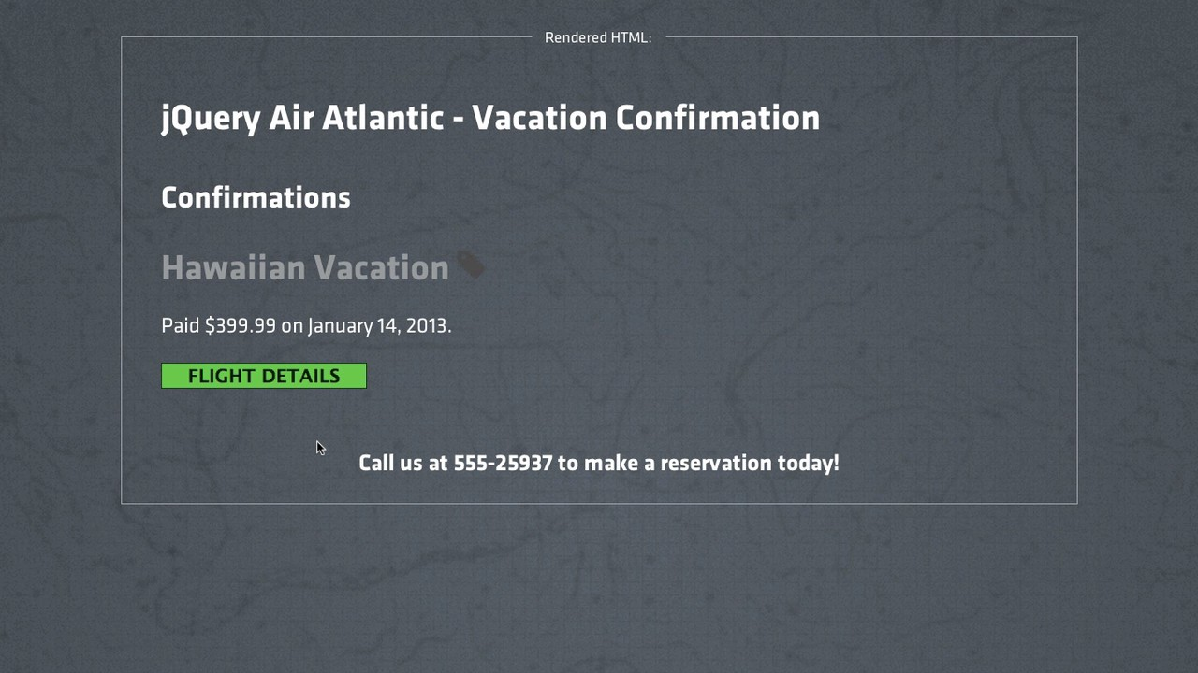
4.1 On DOM Load

Slide 121

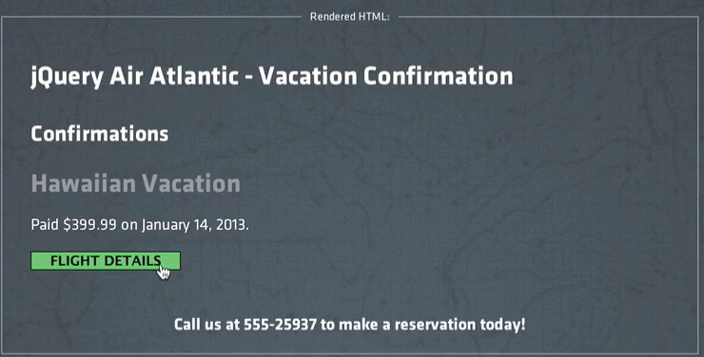






Adding Ticket Confirmation
index.html
<li class="confirmation">
...
<button>FLIGHT
Clicking this button...
DETAILS</button>
<ul
</li>
class="ticket">...</ul>
...will show the ticket
watch for click
.ticket {
display:
none;
}
find the ticket
Hide ticket on page load
show the ticket
4.1 On DOM Load

Slide 122






Using slideDown to Show Elements
jQuery Object Methods
index.html
<li class="confirmation">
.slideDown()
...
<button>FLIGHT DETAILS</button>
<ul class="ticket">...</ul>
</li>
.slideUp()
.slideToggle()
application.js
$('.confirmation').on('click', 'button', function() {
$(this).closest('.confirmation').find('.ticket').slideDown();
});
Searches up through ancestors Searches down through children
4.1 On DOM Load

Slide 123
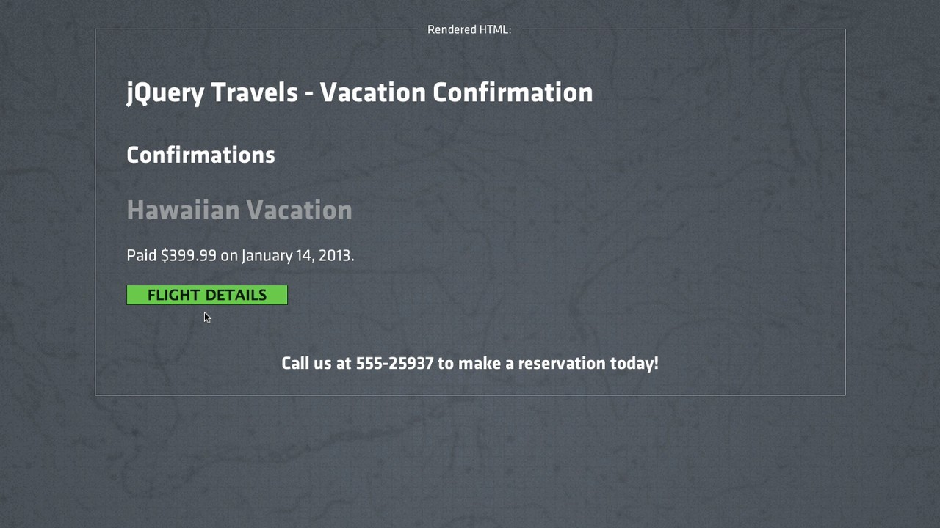

Why doesn’t the button work?

Slide 124

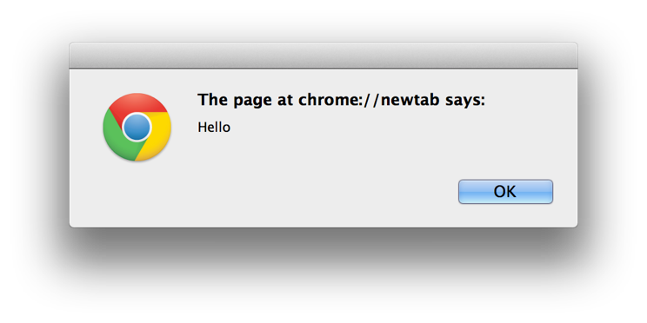


Alert and Length
alert('Hello');
$('li').length;
3
To query how many nodes are on a page.
4.1 On DOM Load

Slide 125



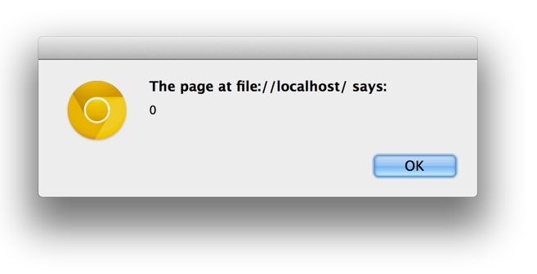
Debugging with Alert
application.js
alert($('button').length);
$('.confirmation').on('click', 'button', function() {
$(this).closest('.confirmation').find('.ticket').slideDown();
});
The alert dialog
4.1 On DOM Load

Slide 126

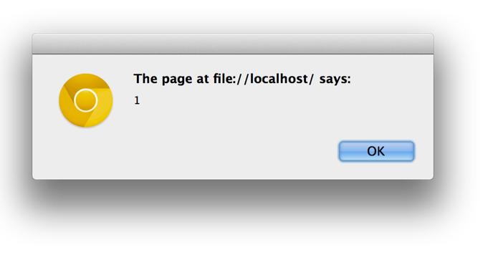

We Forgot $(document).ready() already
application.js
$(document).ready(function() { alert($('button').length);
$('.confirmation').on('click', 'button', function() {
$(this).closest('.confirmation').find('.ticket').slideDown();
});
});
The button is found after the DOM has loaded
4.1 On DOM Load

Slide 127
Now that the DOM has loaded, jQuery can find our button

Slide 128

Expanding on on()

Slide 129
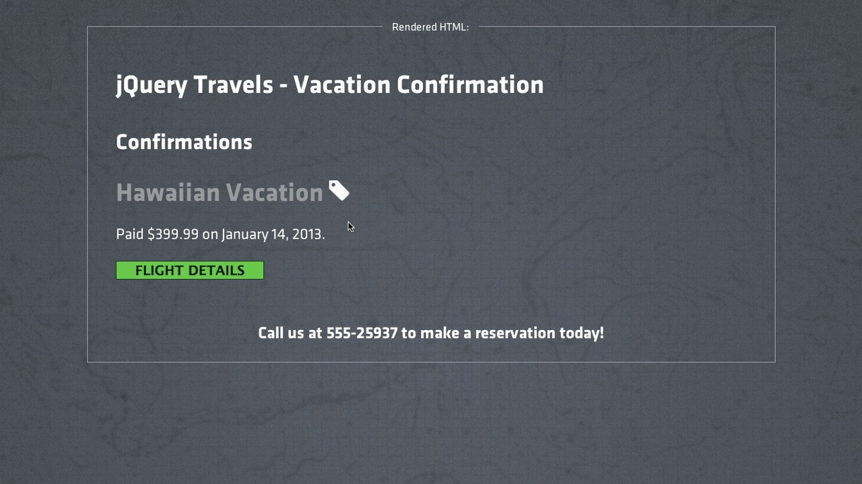

What if we also want to show the ticket when they hover over the <h3> tag?

Slide 130








Deciding on an Event
application.js
$(document).ready(function() {
$('.confirmation').on('click', 'button', function() {
$(this).closest('.confirmation').find('.ticket').slideDown();
});
$('.confirmation').on('?', 'h3', function() {
$(this).closest('.confirmation').find('.ticket').slideDown();
});
What event should we watch for?
});
Mouse Events
Fires when the mouse is first positioned over the element
focusin mousedown mousemove mouseover
click
mouseenter
dblclick
focusout
mouseup
mouseout
mouseleave
4.2 Expanding on on()

Slide 131



Mouse Events
application.js
$(document).ready(function() {
$('.confirmation').on('click', 'button', function() {
$(this).closest('.confirmation').find('.ticket').slideDown();
});
$('.confirmation').on('mouseenter', 'h3', function() {
$(this).closest('.confirmation').find('.ticket').slideDown();
});
});
Show the ticket when the mouse is positioned over the h3
4.2 Expanding on on()

Slide 132
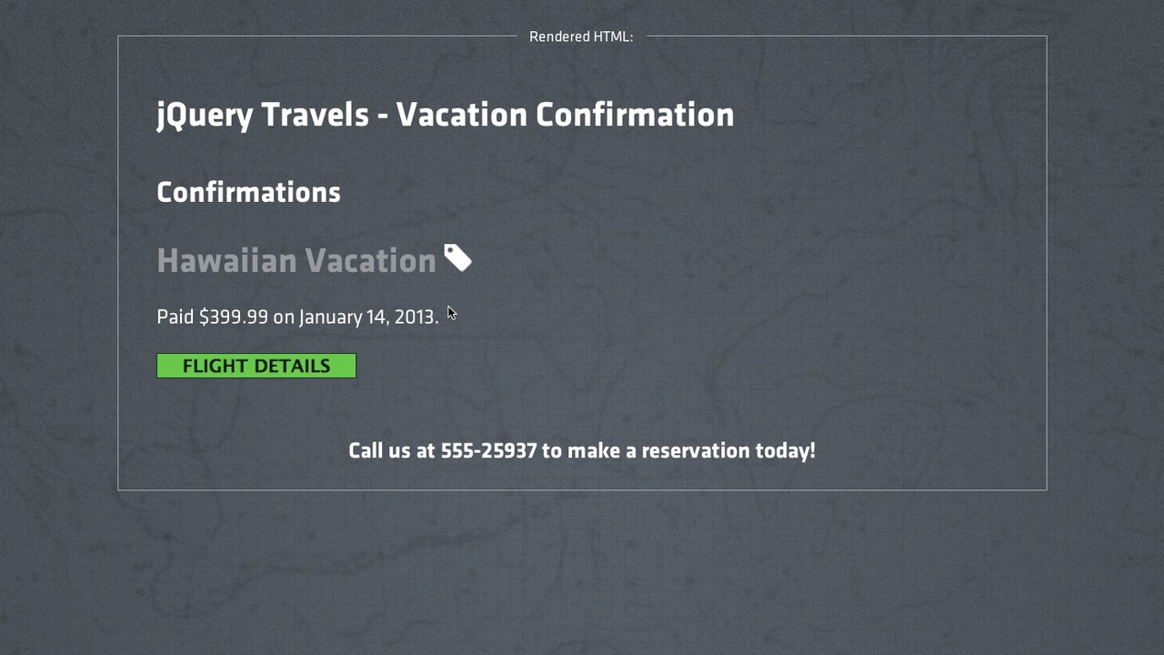
We have two ways of showing the ticket now

Slide 133


Refactoring Handler Functions
application.js
$(document).ready(function() {
$('.confirmation').on('click', 'button',
function() {
$(this).closest('.confirmation').find('.ticket').slideDown();
});
$('.confirmation').on('mouseenter', 'h3', function() {
$(this).closest('.confirmation').find('.ticket').slideDown();
});
});
This code is duplicated, how can we refactor this?
Extract out and name our event handler
function
showTicket () {
$(this).closest('.confirmation').find('.ticket').slideDown();
}
4.2 Expanding on on()

Slide 134

Refactoring Handler Functions
$(this).closest('.confirmation').find('.ticket').slideDown();
}
$(document).ready(function() {
$('.confirmation').on('click', 'button', showTicket);
$('.confirmation').on('mouseenter', 'h3', showTicket);
});
application.js
function
showTicket () {
Don’t add () at the end - that would execute the function immediately
4.2 Expanding on on()

Slide 135
Now the exact same code is run for both events

Slide 136
Keyboard Events

Slide 137
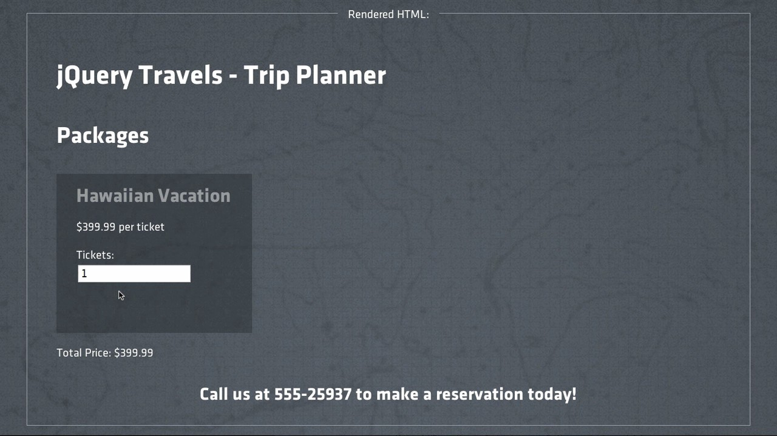
Changing this “Tickets” input field should recalculate the total

Slide 138



Trip Planner Page
index.html
<div class="vacation" data-price='399.99'>
<h3>Hawaiian Vacation</h3>
<p>$399.99
<p>
Tickets:
per ticket</p>
When this updates...
<input
</p>
</div>
type='number'
class='quantity'
value='1' />
<p>Total Price: $<span
id='total'>399.99</span></p>
...we’ll update the calculated price here
4.3 Keyboard Events

Slide 139







Keyboard and Form Events
application.js
$(document).ready(function() {
$('.vacation').on('?', '.quantity',
function() {
});
});
Which event should we use?
Keyboard Events
keypress
Form Events
blur select
change
keydown
focus
submit
http://api.jquery.com/category/events/keyboard-events/ http://api.jquery.com/category/events/form-events/
keyup
4.3 Keyboard Events

Slide 140









Writing our Event Handler
application.js
DOCUMENT
$(document).ready(function() | {
$('.vacation').on('keyup', | '.quantity', | function() | {
// Get the price for this vacation
li
.vacation
// | Get | the | quantity | entered
// | Set | the | total to | price * quantity
p
input
.quantity
});
});
p
span
#total
var price =
'399.99'
$(this).closest('.vacation').data('price');
Returns price as a string
var price
399.99
= +$(this).closest('.vacation').data('price');
Use + to convert the string to a number
4.3 Keyboard Events

Slide 141










Getting the Quantity of Tickets
application.js
DOCUMENT
$(document).ready(function()
$('.vacation').on('keyup',
{
'.quantity', function() {
li
.vacation
var price = +$(this).closest('.vacation').data('price');
// Get the quantity
// Set the total to
});
});
entered
price * quantity
p
input
.quantity
p
span
#total
var quantity
= this.val();
Errors - not a jQuery object
jQuery Object Methods
.val(<new value>)
var quantity
'2'
= $(this).val();
Sets quantity to a string
var quantity
2
= +$(this).val();
Sets quantity to a number
.val()

Slide 142

Setting the Total Price
application.js
DOCUMENT
$(document).ready(function()
$('.vacation').on('keyup',
{
'.quantity', function() {
li
.vacation
var price =
+$(this).closest('.vacation').data('price');
var quantity
= +$(this).val();
p
// Set the total to price *
});
});
quantity
input
.quantity
p
span
#total
$('#total').text(price * quantity);
You can pass a number or a string to the .text() method
4.3 Keyboard Events

Slide 143

The Completed Event Handler
application.js
DOCUMENT
$(document).ready(function()
$('.vacation').on('keyup',
{
'.quantity', function() {
li
.vacation
var price = +$(this).closest('.vacation').data('price'); var quantity = +$(this).val();
p
$('#total').text(price * quantity);
input
.quantity
});
});
p
Whenever the quantity is changed, the total will be updated
span
#total
4.3 Keyboard Events

Slide 144

The total changes immediately as we wanted

Slide 145
Link Layover

Slide 146
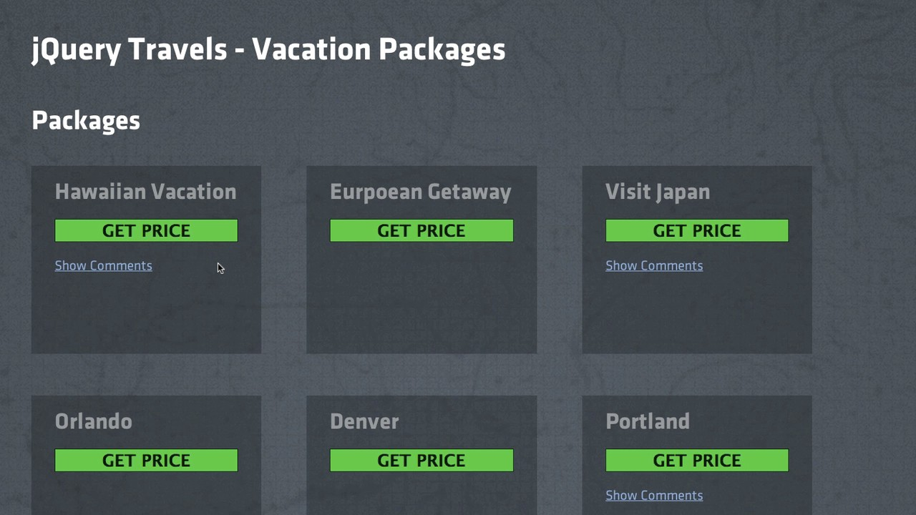
Clicking Show Comments will cause them to fade in

Slide 147


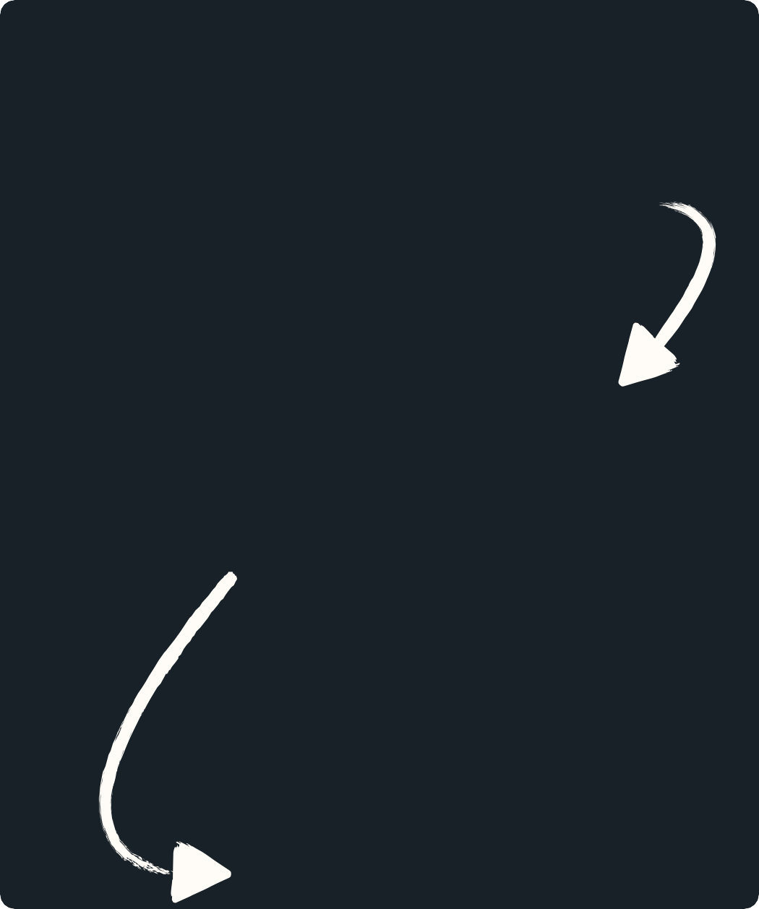







Preparing for Flight
application.css
DOCUMENT
.comments { display: none;
}
ul
Clicking this link...
.vacation
li
a
.expand
application.js
Show
Comments
$(document).ready(function() | {
$('.vacation').on('click', | '.expand', | function() | {
ul
.comments
li li
});
 | // // | Find Show | the the | comments comments | ul ul
});
We need to write the event handler
...will show the comments
4.4 Link Layover

Slide 148


Preparing for Flight
application.js
DOCUMENT
$(document).ready(function() | {
$('.vacation').on('click', | '.expand', | function() | {
// Find
// Show
the comments ul the comments ul
ul
li
.vacation
});
});
a
.expand
Show
Comments
$(this).closest('.vacation').find('.comments')
ul
.comments
li li
Find the .comments ul using traversing
4.4 Link Layover

Slide 149



Preparing for Flight
application.js
DOCUMENT
$(document).ready(function()
$('.vacation').on('click',
{
'.expand',
function() {
$(this).closest('.vacation')
.find('.comments')
ul
li
.vacation
// Show the comments ul
});
});
a
.expand
Show
Comments
jQuery Object Methods
.fadeIn() .fadeOut() .fadeToggle()
These are similar to the slide methods
ul
.comments
li li
4.4 Link Layover

Slide 150




Handling the Click
application.js
DOCUMENT
$(document).ready(function()
$('.vacation').on('click',
{
'.expand',
function() {
$(this).closest('.vacation')
.find('.comments')
.fadeToggle();
ul
li
.vacation
});
});
a .expand
Show
Comments
ul
.comments
fadeIn() .comments on first click, fadeOut() .comments on next click.
li li
4.4 Link Layover

Slide 151
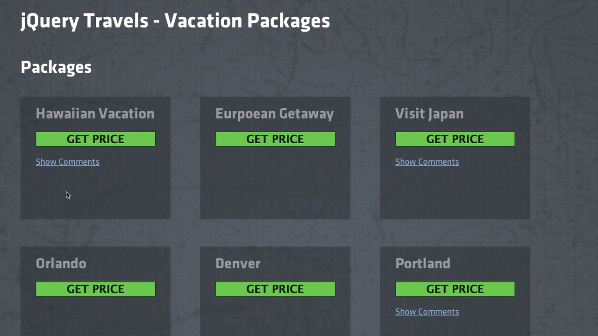
Why does the page jump to the top?

Slide 152





How the Browser Handles the Click
index.html
<a href='#' class='expand'>Show Comments</a>
DOCUMENT
ul
li
.vacation
a
.expand
The click event will “bubble up” to each parent node
Follows the link!
(goes to the top of the page)
Show
Comments
ul
.comments
li li
4.4 Link Layover

Slide 153




The Event Object
application.js
DOM TREE
DOCUMENT
$(document).ready(function()
$('.vacation').on('click',
function(event) {
{
'.expand',
ul
li
.vacation
$(this).closest('.vacation')
.find('.comments')
.fadeToggle();
a
.expand
Show
Comments
});
});
ul
.comments
li li
Add the event parameter
4.4 Link Layover

Slide 154


event.stopPropagation()
application.js
DOM TREE
DOCUMENT
$(document).ready(function()
$('.vacation').on('click', function(event) {
{
'.expand',
ul
li
.vacation
event.stopPropagation();
$(this).closest('.vacation')
.find('.comments')
.fadeToggle();
a
.expand
Show
Comments
ul
.comments
li li
});
});
The browser will still handle the click event but will prevent it
from “bubbling up” to each parent node.
4.4 Link Layover

Slide 155


event.preventDefault()
application.js
DOM TREE
DOCUMENT
$(document).ready(function()
$('.vacation').on('click', function(event) {
{
'.expand',
ul
li
.vacation
event.preventDefault();
.expand
a
$(this).closest('.vacation')
.find('.comments')
.fadeToggle();
Show
Comments
ul
.comments
}
);
});
li li
The click event will “bubble up” but the browser won’t handle it
4.4 Link Layover

Slide 156
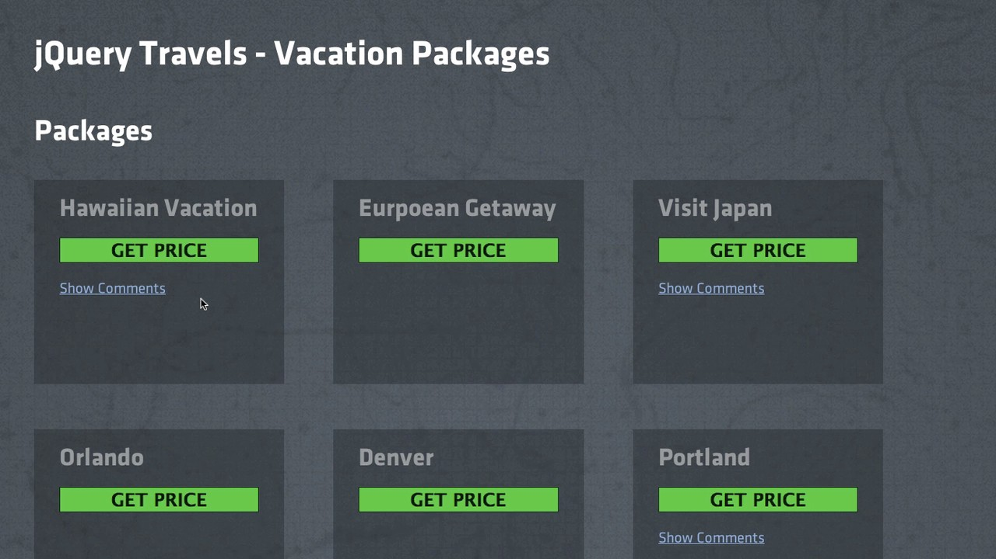
We’re preventing the default action of the browser now.

Slide 157
level5

Slide 158
Taming CSS

Slide 159


Separation of Concerns
HTML
To style something based on user interaction, which would we use?
content
CSS
style
JavaScript
behavior
5.1 Taming CSS

Slide 160


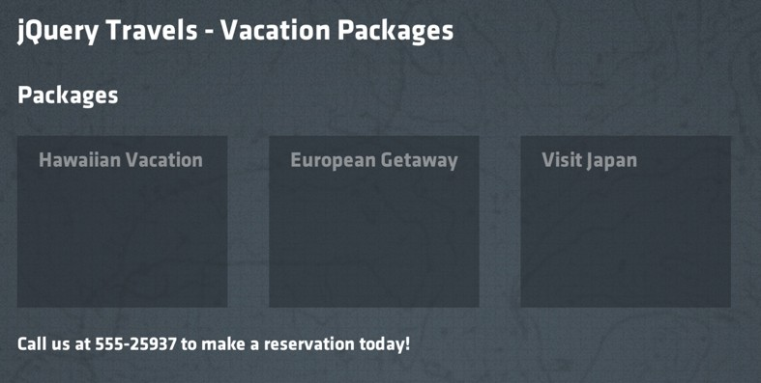





Changing our Style
DOM representation
DOCUMENT
div
#vacations
ul
li
.vacation
p
.price
...and allow people to click on the <li> element
Let’s make all .vacation elements clickable...
5.1 Taming CSS

Slide 161









Changing the Style
DOM representation
application.js
$(document).ready(function()
$('#vacations').on('click',
DOCUMENT
{
'.vacation',
function() {
div
#vacations
$(this).css('background-color',
'#252b30');
$(this).css('border-color',
});
});
'1px solid #967');
ul
li
.vacation
p
.price
$(this).css('background-color',
'#252b30')
jQuery Object Methods
.css(<attr>, <value>)
.css(<attr>)
.css('border-color', '1px
solid #967');
$(this).css({'background-color':
'#252b30',
'border-color': '1px solid #967'});
Passing in a JavaScript Object as an argument is a common jQuery pattern
.css(<object>)
5.1 Taming CSS

Slide 162




Showing the Price
DOM representation
application.js
$(document).ready(function()
$('#vacations').on('click',
DOCUMENT
{
'.vacation', function() {
div
#vacations
$(this).css({'background-color': '#252b30',
'border-color': '1px solid #967'});
ul
});
});
li
.vacation
p
.price
$(this).find('.price').css('display',
'block');
jQuery Object Methods
.show()
$(this).find('.price').show();
Same as CSS syntax, but easier to read and understand
.hide()
5.1 Taming CSS

Slide 163


Showing the Price
DOM representation
application.js
$(document).ready(function()
$('#vacations').on('click',
DOCUMENT
{
'.vacation',
function() {
div
#vacations
$(this).css({'background-color':
'#252b30',
'border-color': '1px
$(this).find('.price').show();
});
});
solid #967'});
ul
li
.vacation
p
.price
Highlights the Vacation Package and shows the price
5.1 Taming CSS

Slide 164
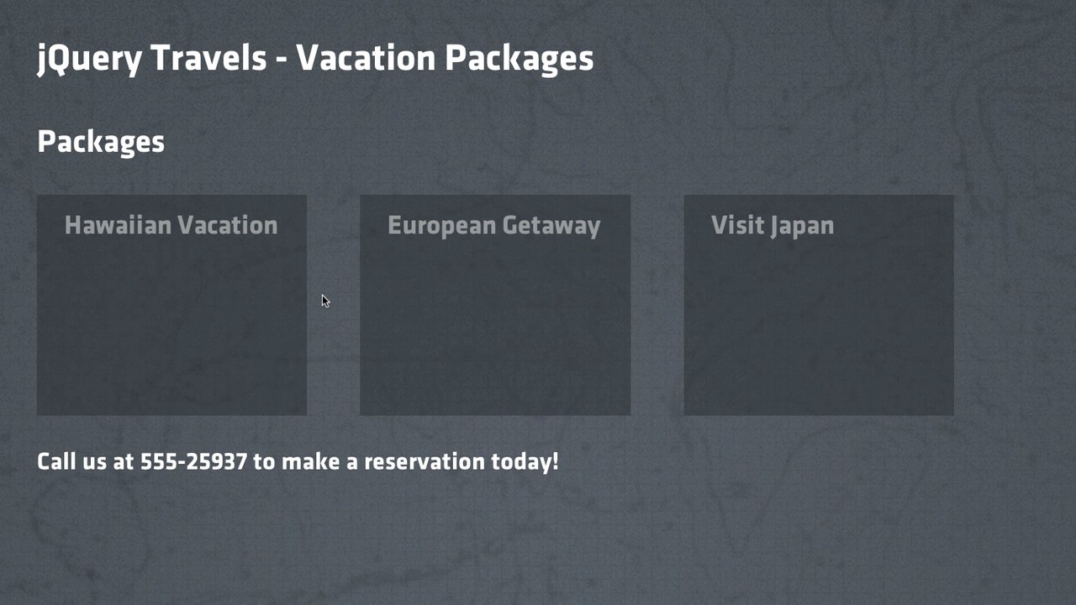
Our .vacation elements are highlighted when we click on them

Slide 165






Moving Styles to External CSS
DOM representation
application.js
DOCUMENT
$(document).ready(function()
$('#vacations').on('click',
{
'.vacation',
function() {
div
#vacations
$(this).css({'background-color':
'#563',
'border-color': '1px
$(this).find('.price').show();
solid #967'});
ul
});
});
li
.vacation
p
.price
Can we move these to a CSS stylesheet?
application.css
.highlighted {
$(this).addClass('highlighted');
background-color: #563; border-color: 1px solid #967;
}
.highlighted .price { display: block;
}
5.1 Taming CSS

Slide 166

Moving Styles to External CSS
DOM representation
application.js
DOCUMENT
$(document).ready(function()
$('#vacations').on('click',
{
'.vacation',
function() {
div
#vacations
$(this).addClass('highlighted');
});
});
ul
li
.vacation
It’s now much easier to manipulate with external CSS styles
p
.price
application.css
.highlighted { background-color: #563;
border-color: 1px solid #967;
}
.highlighted .price { display: block;
}
5.1 Taming CSS

Slide 167



Moving Styles to External CSS
DOM representation
application.js
DOCUMENT
$(document).ready(function()
$('#vacations').on('click',
{
'.vacation',
function() {
div
#vacations
$(this).addClass('highlighted');
});
});
ul
li
.vacation
We can only show price, but how would we hide price?
p
.price
$(this).toggleClass('highlighted');
Adds the class if $(this) doesn’t have it, removes it if $(this) already has it
jQuery Object Methods
.toggleClass()
.addClass(<class>)
.removeClass(<class>)
5.1 Taming CSS

Slide 168

Our refactored page still works, and will be much easier to maintain

Slide 169
Challenges
5.1 Taming CSS

Slide 170
Animation

Slide 171
What can we do to add a bit more movement to this?

Slide 172



Adding Movement
DOM representation
application.js
$(document).ready(function()
$('#vacations').on('click',
DOCUMENT
{
'.vacation',
function() {
div
#vacations
$(this).toggleClass('highlighted');
});
});
ul
li
.vacation
p
.price
$(this).css({'top':
'-10px'});
The box will jump up 10 px
jQuery Object Methods
.animate(<object>)
Takes in a JavaScript object similar to the .css() method
$(this).animate({'top':
'-10px'});
5.2 Animation

Slide 173

Adding Movement
DOM representation
application.js
$(document).ready(function()
$('#vacations').on('click',
DOCUMENT
{
'.vacation', function() {
div
#vacations
$(this).toggleClass('highlighted');
$(this).animate({'top': '-10px'});
ul
});
});
li
.vacation
Will adjust a CSS property pixel by pixel in order to animate it
p
.price
5.2 Animation

Slide 174
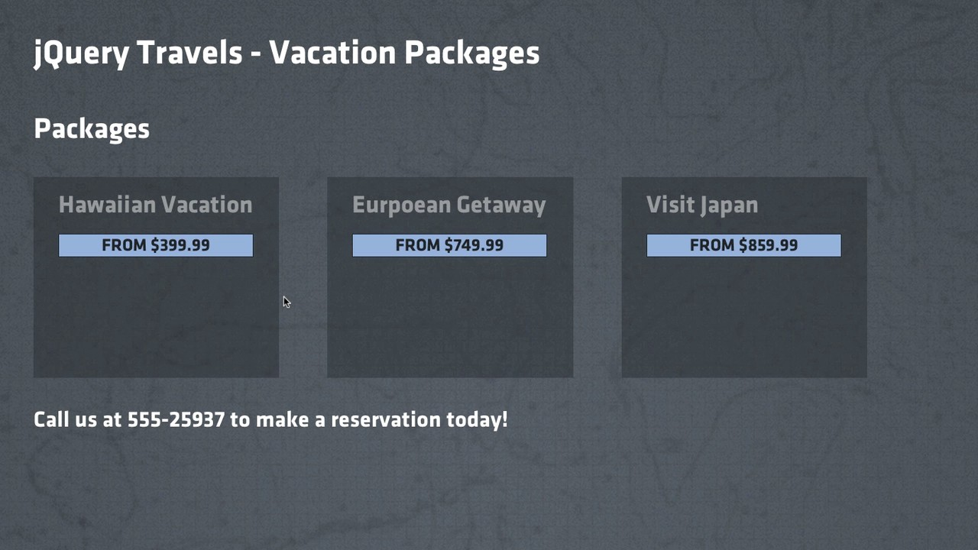
Our animation can slide up but not slide down

Slide 175



Moving Back Down
DOM representation
application.js
$(document).ready(function()
$('#vacations').on('click',
DOCUMENT
{
'.vacation',
function() {
div
#vacations
$(this).toggleClass('highlighted');
$(this).animate({'top':
});
});
'-10px'});
ul
li
.vacation
How do we set ‘top’ to ‘0px’ if a second click occurs?
p
.price
if(<vacation | has | the class highlighted>) | {
// animate | the | vacation up
} else {
// animate
the vacation
back
down
}
“If statements” allow your code to make decisions at runtime
5.2 Animation

Slide 176



Moving Back Down
DOM representation
application.js
$(document).ready(function()
$('#vacations').on('click',
DOCUMENT
{
'.vacation',
function() {
div
#vacations
$(this).toggleClass('highlighted');
if(<vacation has the class
highlighted>) {
ul
$(this).animate({'top': '-10px'});
} else {
li
.vacation
$(this).animate({'top':
}
});
});
'0px'});
p
.price
jQuery Object Methods
.hasClass(<class>)
$(this).hasClass('highlighted'); true
Returns true or false
5.2 Animation

Slide 177

Moving Back Down
DOM representation
application.js
$(document).ready(function()
$('#vacations').on('click',
DOCUMENT
{
'.vacation', function() {
div
#vacations
$(this).toggleClass('highlighted');
if($(this).hasClass('highlighted')) {
ul
$(this).animate({'top': '-10px'});
} else {
li
.vacation
$(this).animate({'top':
}
});
});
'0px'});
p
.price
Our vacation package will move up and down
5.2 Animation

Slide 178

Could we speed this up a little? Our customers don’t have all day.

Slide 179



Changing the Speed
$(this).animate({'top':
'-10px'});
'-10px'}, 400);
We can optionally pass in the speed as a second argument to animate()
$(this).animate({'top':
$(this).animate({'top':
'-10px'},
'fast');
$(this).animate({'top':
'-10px'},
200);
$(this).animate({'top':
'-10px'},
'slow');
$(this).animate({'top': '-10px'}, 600);
Efects methods like animate(), slideToggle() and fadeToggle()
can also be given a specific speed as a String or in milliseconds
5.2 Animation

Slide 180

Moving Back Down
DOM representation
application.js
$(document).ready(function()
$('#vacations').on('click',
DOCUMENT
{
'.vacation',
function() {
div
#vacations
$(this).toggleClass('highlighted'); if($(this).hasClass('highlighted')) {
ul
$(this).animate({'top': '-10px'}, 'fast');
} else {
li
.vacation
$(this).animate({'top': '0px'}, 'fast');
p
}
});
});
.price
And with this we now have specific speeds for our animation
5.2 Animation

Slide 181
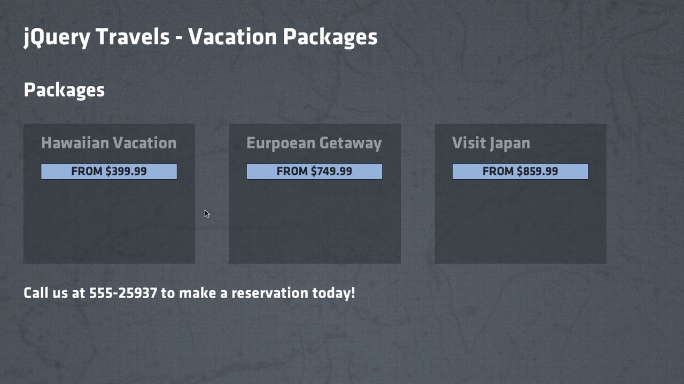
Our jQuery animation is now using a ‘fast’ speed

Slide 182
The Next Step with CSS Animations
DOM representation
application.js
DOCUMENT
$(document).ready(function()
$('#vacations').on('click',
{
'.vacation',
function() {
div
#vacations
$(this).toggleClass('highlighted');
if($(this).hasClass('highlighted'))
$(this).animate({'top': '-10px'},
{
'fast');
ul
} else {
$(this).animate({'top': '0px'}, 'fast');
}
li
.vacation
p
.price
});
});
Isn’t this still styling? Shouldn’t it be inside of a stylesheet?
5.2 Animation

Slide 183




Animation Duration
DOM representation
application.js
$(document).ready(function()
$('#vacations').on('click',
DOCUMENT
{
'.vacation',
function() {
div
#vacations
$(this).toggleClass('highlighted');
});
});
ul
li
.vacation
application.css
.vacation {
p
.price
transition:
top 0.2s;
}
.highlighted { top: -10px;
}
Will only work with browsers that implement CSS transitions
5.2 Animation

Slide 184


Working with Modern Browsers
DOM representation
application.js
DOCUMENT
$(document).ready(function()
$('#vacations').on('click',
{
'.vacation',
function() {
div
#vacations
$(this).toggleClass('highlighted');
});
});
ul
li
.vacation
application.css
.vacation {
-moz-transition:
p
.price
top 0.2s;
-o-transition: top
0.2s;
Unlike jQuery, with CSS we have to account for specific browsers
-webkit-transition:
top 0.2s;
transition: top 0.2s;
}
.highlighted { top: -10px;
}
5.2 Animation

Slide 185
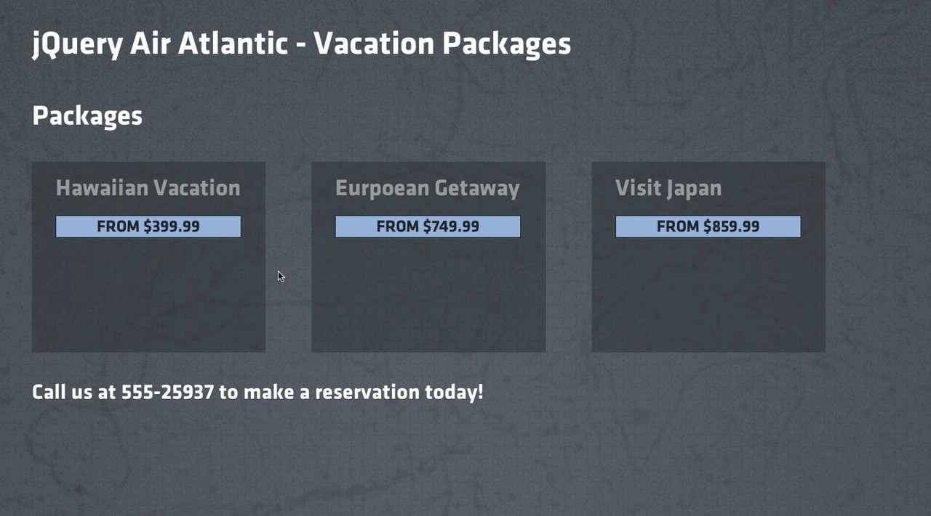
CSS Animations are a huge topic, but worth looking into

